Slide 1
AN ANALYTICAL MODEL TO STUDY OPTIMAL AREA BREAKDOWN BETWEEN CORES AND CACHES IN A CHIP MULTIPROCESSOR
Taecheol Oh, Hyunjin Lee, Kiyeon Lee
and Sangyeun Cho

Slide 2
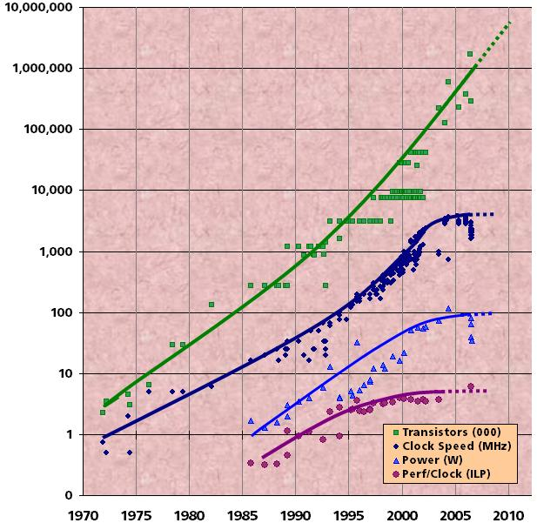
Processor design trends
Clock rate, core size, core performance growth have ended
How many cores shall we integrate on a chip?
(or how much cache capacity)
Transistors(000)
Clock Speed (MHZ)
Power (W)
Perf/Clock
UC Berkeley 2009
Notes:
Moore’s law reinterpreted
Number of cores per chip will double every two years
Clock speed will not increase (possibly decrease)
The chip size will remain constant

Slide 3
How to exploit the finite chip area
A key design issue for chip multiprocessors
The most dominant area-consuming components in a CMP are cores and caches
Too few cores :
System throughput will be limited by the number of threads
Too small cache capacity :
System may perform poorly
We presented a first order analytical model to study the trade-off of the core count and the cache capacity in a CMP under a finite die area constraint

Slide 4
Talk roadmap
Unit area model
Throughput model
Multicore processor with L2 cache
Private L2
Shared L2
UCA (Uniform Cache Architecture)
NUCA (Non-Uniform Cache Architecture)
Hybrid
Multicore processor with L2 and shared L3 cache
Private L2
Shared L2
Case study

Slide 5
Unit area model
Given die area A, core count N, core area Acore and cache area AL2 , AL3
Define A1 as the chip area equivalent to a 1MB cache area
c₁
c₂
c_{N}
Area for Cores
≥
Area for Caches(L2 / L3)
A₁
Where m and c are design parameters

Slide 6
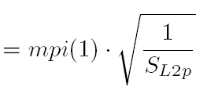
Throughput model
IPC as the metric to report system throughput
To compute IPC, we obtain CPI of individual processors
A processor’s “ideal” CPI can be obtained with an infinite cache size
mpi : the number of misses per inst. for the cache size,
The square root rule of thumb is used to define mpi. [Bowman et al. 07]
mpM : the average number of cycles needed to access memory and handle an L2 cache miss

Slide 7
Modeling L2 cache
Core 0
Core 0
Core 0
Core 0
• • • • • •
L1
L1
L1
L1
• • • • • •
L2
L2
L2

Slide 8
Modeling private L2 cache
Private L2 cache offers low access latency, but may suffer from many cache misses
CPIpr is the CPI with an infinite private L2 cache (CPIideal)
Per core private cache area and size

Slide 9
Modeling shared L2 cache
Shared L2 cache shows effective cache capacity than the private cache
CPIsh is the CPI with an infinite shared L2 cache (CPIideal)
SL2sh is likely larger than SL2p
There are cache blocks being shared by multiple cores
A cache block is shared by Nsh cores on average

Slide 10
Modeling shared L2 cache
UCA (Uniform Cache Architecture)
Assuming the bus architecture
Contention factor
NUCA (Non Uniform Cache Architecture)
Assuming the switched 2D mesh network
B/W penalty factor, average hop distance, single-hop traverse latency
Network traversal factor
Hybrid
Cache expansion factor σ

Slide 11
Modeling on-chip L3 cache
Parameter α to divide the available cache area between L2 and L3 caches
Core 0
Core 0
Core 0
Core 0
• • • • • •
L1
L1
L1
L1
• • • • • •
L2
L2
L2
L3
L3

Slide 12
Modeling private L2 + shared L3
Split the finite cache CPI into private L2 and L3 components
Private L2 cache size and shared L3 cache size

Slide 13
Modeling shared L2 + shared L3
Split the finite cache CPI into shared L2 and L3 components
UCA (Uniform cache Architecture)
Contention factor
NUCA (Non uniform cache Architecture)
Network traversal factor
Hybrid
Cache expansion factor σ

Slide 14
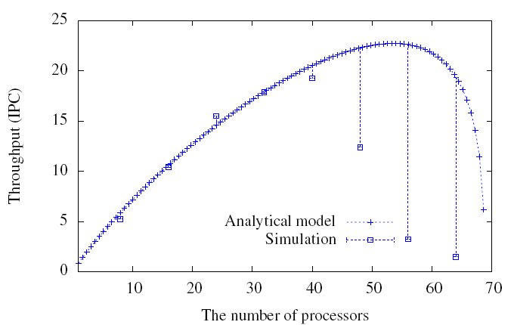
Validation
Comparing the IPC of the proposed model and the simulation (NUCA)
TPTS simulator [Cho et al. 08]
Models a multicore processor chip with in-order cores
Multi threaded workload
Running multiple copies of single program
Benchmark
SPECK2k CPU suite
Good agreement with the simulation before a “breakdown point” (48 cores)
Notes:
Around 20 mb

Slide 15
Case study
Employ a hypothetical benchmark
To clearly reveal the properties of different cache organizations and the capability of our model
Select base parameters
Obtained experimentally from the SPEC2k CPU benchmark suite
Change the number of processor cores
Show how that affects the throughput
Chip area, core size, and the 1 MB cache area
At most 68 cores (with no caches) and 86 MB cache capacity (with no cores)

Slide 16
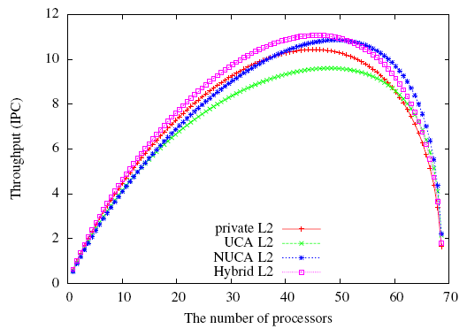
Performances of different cache design
Performance of different cache organization peaks at different core counts.
Hybrid scheme exhibits the best performance
Shared scheme can exploit more cores
The throughputs drop quickly as more cores are added
The performance benefit of adding more core is quickly offset by the increase in cache misses

Slide 17
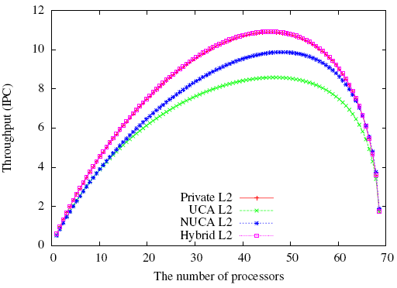
Effect of on-chip L3 cache (α= 0.2)
The private and hybrid schemes outperform the shared schemes
The relatively high miss rate of the private scheme is compensated by the on-chip L3 cache (low access latency to private L2)

Slide 18
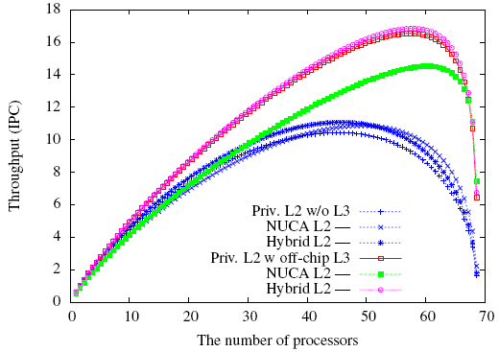
Effect of off-chip L3 cache
With the off-chip L3 scheme favors over without off-chip L3
The private and the hybrid schemes benefit from the off-chip L3 cache the most
Notes:
Off-chip 128 MB

Slide 19
Conclusions
Presented a first order analytical model to study the trade-off between the core count and the cache capacity
Differentiated shared, private, and hybrid cache organizations
The results show that different cache organizations have different optimal core and cache area breakdown points
With L3 cache, the private and the hybrid schemes produce more performance than the shared scheme, and more cores are allowed to be integrated in the same chip area (e.g. Intel Nehalem, AMD Barcelona)

Slide 20
Question

