Slide 1

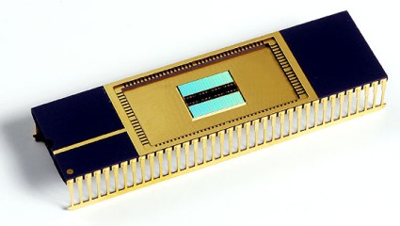

PRISM: Zooming in
Persistent RAM Storage Behavior
Juyoung Jung and Dr. Sangyeun Cho
Dept. of Computer Science
University of Pittsburgh
Notes:
Hello Everyone.
I am Juyoung Jung from University of Pittsburgh.
Today, I am going to present a paper “PRISM: Zooming in Persistent RAM Storage Behavior”.
This work is done with my advisor Professor Sangyen cho.

Slide 2
Contents
Introduction
Background
PRISM
Preliminary Results
Summary
Notes:
In this talk, I first give an introduction and background to our work.
Then, after I am going to explain our tool, PRISM, in details, I present the preliminary results showing how PRISM can help storage designers to explore the design space of persistent RAM based storage device.
Finally, I summarize our work.

Slide 3
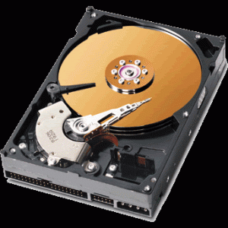
Technical Challenge
HDD
- Slow and
- Power hungry
Fundamental solution?
Alternative storage medium
Notes:
There is a long-standing performance and power bottleneck on modern computer system.
It is a slow and power-hungry HDD based storage device.
Then, what is the fundamental solution for addressing this problem?
One solution is to use alternative storage medium rather than magnetic disk.

Slide 4
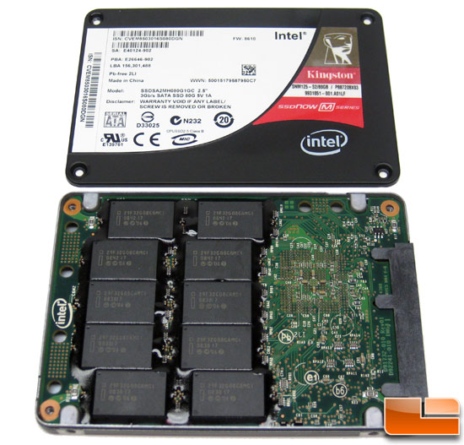
Technical Challenge
NAND flash based SSD
+ much faster
+ better energy
+ smaller …
- erase-before-write
- write cycles
- unbalanced rw
- scalability …
Notes:
In the response of need for new medium, NAND flash based solid-state storage devices recently attract much interest from storage designers and even system designers.
Basically, SSD’s operations are based on chip-level signaling rather than mechanical movement.
Therefore, NAND flash memory is much faster, less power consuming, and smaller than HDD. In addition, it has stronger shock resilience.
With SSD, the performance gap between main memory and storage system get filled up somewhat.
However, there are critical downsides in flash memory technology.
For example, NAND memory is governed by erase-before-write operation. Thus, whenever we need to update data, we must first perform erase operation that takes long time around 2ms.
More worse, NAND has very tight write cycles and unbalanced read/write performance.
Lastly, we are not sure if NAND flash is scalable with future deep-nano process technology beyond 22nm.
Then, is there any better memory technology than NAND flash memory as a storage medium?
Fortunately, yes, there are.

Slide 5

Emerging Persistent RAMs Technologies
 | Latency |  |  | Program energy | Endurance | Density
 | Read | Write | Erase
NAND flash | 25us | 200us | 1.5ms | 10nJ | 10⁴~10⁶ | 4~5F²
PCM | 20ns | 100ns | N/A | 100pJ | 10⁸~10⁹ | 5F²
STT-RAM | 10ns | 10ns | N/A | 0.02pJ | 10¹⁵ | 4F²
RRAM | 10ns | 20ns | N/A | 2pJ | 10⁶ | 6F²
FeRAM | 75ns | 50ns | N/A | 2pJ | 10¹³ | 6F²
PRAMs Win !
Notes:
This table compares various PRAM technologies.
As you can see, all of new emerging PRAMs have much better physical characteristics than NAND flash memory.
First of all, PRAM is byte-addressable as like DRAM.
They are much faster and more energy-efficient than NAND flash memory.
Also, they are not restricted by erase-before-write constraint, and so possible to update data in-place.
As another advantage, they are scalable less than 22nm.
Since all PRAMs are non-volatile, they are most promising candidate media for future storage device.

Slide 6

Write endurance
Read/write imbalance
Latency
Energy
consumption
Technological maturity
Notes:
However, we quickly have a bunch of questions.
Some PRAMs have relatively faster than others, and Others are nearly free from the limited write cycles.
Some PRAMs still have the limited write cycles although it is much higher than NAND flash.
In addition, some PRAMs suffer from unbalanced read and write performance but others are free from the problem.
Also, some PRAMs are immature technology that work only in the laboratory, but others have already been proven with the working silicon.
How will all of these factors shape the storage system having PRAM storage device?

Slide 7
Our Contribution
There is little work to evaluate Persistent RAM based Storage Device (PSD)
  Research environment not well prepared
Present an efficient tool to study the impact of PRAM storage device built with totally different physical properties
Notes:
Here is our contribution.
Since there is little work to evaluate PRAM based storage device, the environment to do research on PSD is not well prepared yet.
Thus, assuming PSD are introduced into storage system, we design and implement an efficient tool to study the impact of PRAM storage device with totally different physical properties.

Slide 8
PRISM
PeRsIstent RAM Storage Monitor
Study Persistent RAM (PRAM) storage behavior
  Potentials of new byte addressable storage device
  PRAMs’ challenges as storage media
Guide PSD (PRAM Storage Device) design
  Measure detailed storage activities (SW/HW)
Notes:
The tool is PRISM. Persistent RAM storage monitor.
PRISM can help study PRAM storage behavior.
In other words, with PRISM, we can evaluate potentials of new byte addressable storage device and the PRAM’ challenges as storage media.
Especially, to guide PSD design, PRISM provide the detailed storage activities including both software and hardware part.

Slide 9
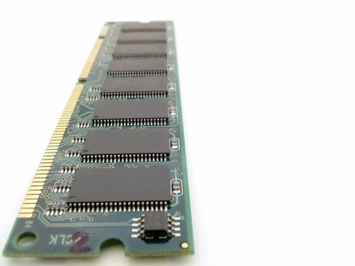
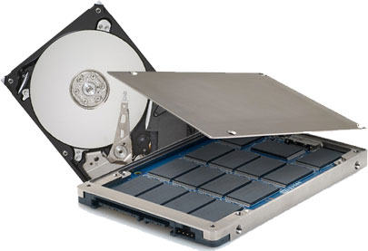

PRISM
HDD or SSD
PSD
Block devices
Non-Block devices
Notes:
PRISM is targeting to monitor non-block device, PSD, rather than the traditional block devices.

Slide 10


PRISM
test.exe
Low-level storage behavior
read(file1)
OS virt. addr
address mapping
write(buf,file1)
wear leveling
PRAM phys. addr
bit masking
data values
exploit parallelism
access frequency
resource conflicts
metadata impact
cell wearing stat
etc.
Notes:
This diagram shows the conceptual view of PRISM workflow.
When users run their applications, at some point, it may issue storage access requests by invoking read or write system calls.
While these requests are served with OS storage-related layers and storage device as usual, at the same time, PRISM takes the requests, and generate the statistics of low-level access activities occurring at storage subsystem.
The information will be used for exploring PSD based storage system design space such as determining hardware organization and wear-leveling strategies.

Slide 11
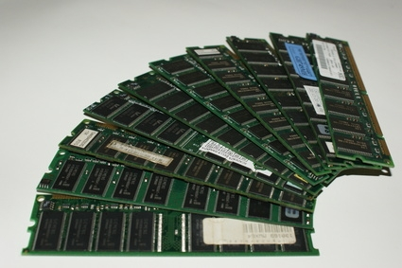
PRISM Implementation Approach
Instrumentation
Technique
User Applications
Virtual File System
Individual FS (EXT3, HFS, TMPFS, etc.)
Buffer/Page Cache
Block I/O Layer
HDD/SSD device driver
Tracers
SW
File system
Tracers
Emulation
I/O scheduler
Holistic Approach
Interconnect
PSD
HW
Slots, chips
Simulation
Notes:
We need to choose PRISM implementation approach.
This diagram shows the conventional storage subsystem.
The storage subsystem is complicated artifacts composed of software and hardware.
So we adopt the holistic approach considering both software and hardware in one place.
Also, since we want to run a realistic workload fast, we combine emulation approach with simulation instead of relying only on simulation.
In addition, because we want to monitor accurate, low-level storage activities, we used code instrumentation technique by embedding our tracers into kernel source deeply.

Slide 12

PRISM Components
User Apps
Frontend Tracer
PRISM
Backend PSDSim
Notes:
This diagram shows the overall PRAM architecture.
PRISM consist of two major components. Frontend tracer and backend simulator.
Let’s look into the frontend component in more details.

Slide 13
Frontend Tracer
Application
write
File I/O requests
Linux VFS
write
In-memory TMPFS file system
write
Write data
Tracer Module
Metadata
Tracer Module
User-defined
Tracer Modules
Invoking
WR tracer
Proc-based Logger
access time
byte-granule
request info
……
Raw data gathered
Notes:
Frontend tracer has a responsible for recording activities occurred at OS storages related stack and storing the information into a file via logging system.
Let me give an example with write operation path.
When application issue write request, the request will be received by linux virtual file system.
Then, Linux VFS calls a specific file system related to the write request. In our case, it is in-memory temp file system.
When this temp file system handles the write request, our write tracer will be invoked to capture the necessary low-level information. The captured information will be output to the named file through proc based logging system.
Once this process completes, we are ready to proceed to PRISM backend component.

Slide 14
PRISM Components
User Apps
Frontend Tracer
PRISM
Backend PSDSim
Notes:
Let us look into backend PSDsim in more details.

Slide 15
Backend Event-driven PSDSim
the used PRAM technology
storage capacity
# of packages, dies, planes
fixed/variable page size
wear-leveling scheme …
Raw trace data
Storage configuration
Persistent RAM storage simulator (PSDSim)
PRAM Reference
Statistics Analyzer
PRAM
Storage Controller
Wear leveling Emulator
PRAM
Energy Model
Various performance results
Notes:
This diagram shows backend event-driven PSDSim.
This takes as inputs the raw trace gathered from frontend and storage configuration specification.
For example, what is the used PRAM technology? What is the storage capacity and the number of packages, dies, and planes? What is the wear-leveling strategies used?
PSDSim consists of four components.
PRAM storage controller regulates the overall simulation process. The wear-leveling emulator is used for comparing the wear-leveling strategies. Also, PSDSim has a PRAM energy model based on cell-level energy number.
When the simulation has done, the generated performance statistics will be analyzed with PRAM reference statistics analyzer and automatically transformed into graphs.

Slide 16
Preliminary Results of Case Study
Objective: enhancing PRAM write endurance
Experimental Environment
Components | Specification
CPU | Intel Core Duo 1.66 GHz (32-bit)
L2 Cache | 2 MB
Main Memory | 1 GB SDRAM
Operating System | Linux 2.6.24
File System | Tmpfs 10 GB capacity
Workload | TPC-C 2-hours measurement
Notes:
We performed case study so that we show how PRISM can help storage designers with its diverse functionalities.
The goal of this case study is assumed to enhance PCM write endurance.
Here is our experimental environment.
Our host system features with 32bit dual core and 1GB main memory.
And it is running Linux operating system with 10GB tmpfs file system.
As our workload, we used a representative OLTP benchmark, TPC-C.
We employ PostgreSQL 8.1.4 as database engine and configured single warehouse and 10 terminals and measured for 2-hours test.

Slide 17
Possible Questions from Designers
How our workloads generate writes to storage?
  Temporal behavior of write request pattern
  The most dominant data size written
  Virtual address space used by OS
  File metadata update pattern
What about hardware resource access pattern?
  Resource utilized efficiently
  Do we need consider wear-leveling?
Notes:
Storage designers may have the following questions during running his applications.
First, they definitely want to know how their target workloads produce the write requests to PSD.
They may want to see the temporal behavior of those write requests.
For instance, will the writes be requested with constant rate or in burst? If in burst, how bursty are they?
Also, designers may wonder what the most dominant data size written into device? Will the actual written sizes be same as the originally requested size?
Besides, designers want to peek how their application is using the virtual address space of the application.
On top of that, they may have an interest on metadata update pattern that has relatively small size compared to file data.
Except for understanding the behavior of Operation System-side, storage designers want to know how they must organize the hardware components to get best performance.
They will get an insight on that by monitoring and changing internal hardware configuration.
If they are going to use PRAM with the limited write cycles, they need know the effect of their wear-leveling strategy.
PRISM can successfully answer the above questions.
Let’s look at the preliminary results with running TPC-C benchmark.

Slide 18
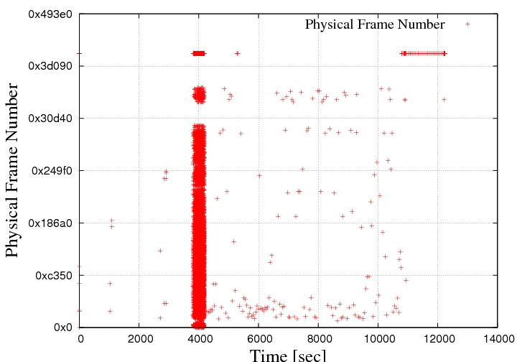
TPC-C File update pattern
Temporal behavior of writes
Populating 9 relational tables
writes are very bursty
proper queue size
(Wall-clock time)
Notes:
This graph answers how TPC-C generates write requests over time.
As you can see, write requests has been issued densely around 4K second. Most of write request happened within this short period time, when it is populating the necessary 9 relational tables. After then, it issues only small number of writes for data record update and logging.
Since the write request is significantly in burst, designers must make sure they provide the sufficient depth of write buffer to accommodate the bursty requests.

Slide 19
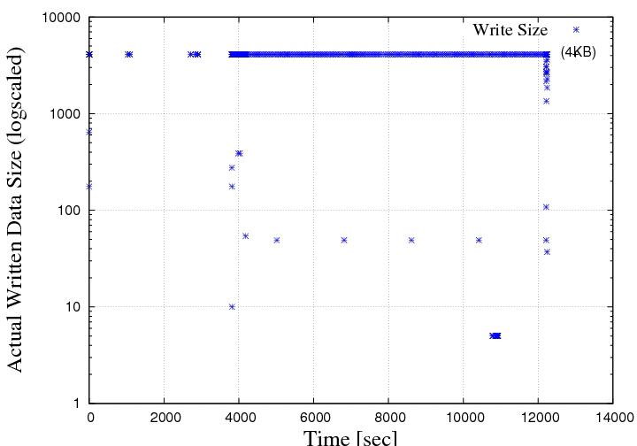
File Data Written Size
4KB written size dominant
Not cause whole block update
Notes:
This graph can answer what the dominant actual written data size was.
In our test, we observed 4KB-sized data is actually written most.
However, designers also note there are smaller sized data written than 4KB.
If we were using the tradition block device, these smaller sized write would cause the entire block update.
Even if we didn’t show this slide, the most dominant requested write size are not 4KB, but 8KB.
When Linux storage subsystem receives larger sized data write request, it first split them into smaller page-sized requests, and then perform the smaller requests. If you look at the details for this , you can refer our paper.

Slide 20
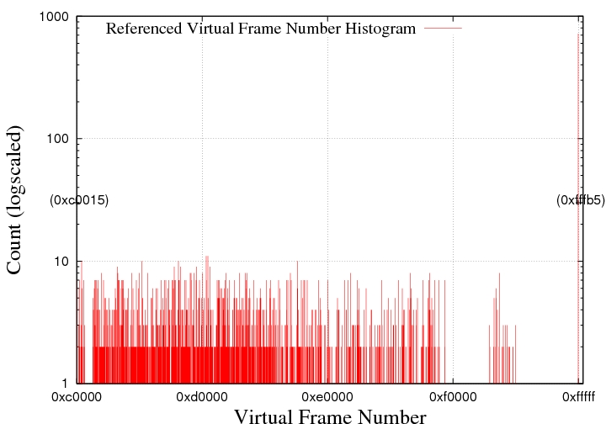
Virtual Page Reuse Pattern
HIGHMEM
OS VMM allocates pages
from low memory
Notes:
This graph answers what virtual address range Operating system reuse heavily. This may affect the address mapping from virtual to physical.
As you can see, most of write requests are using low memory address, but some requests are served with the address of HIGHMEM region.
Since HIGHMEM region has only small number of pages, the virtual address to the pages get much reused. Thus, storage designer may want to recycle the pages mapped to HIGHMEM region in order to avoid the fast wear-out of those pages.

Slide 21
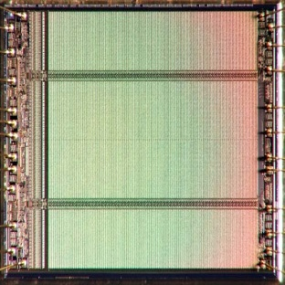
Example Hardware Organization
256MB package 0
PKG 0
Die 0
Die 1
1GB PSD
PKG 1
16MB plane 7
8 planes in
128MB Die 1
Plane 7
Page 0
Plane1
PKG 2
Plane1
Page 1
Plane1
Page 2
Plane 0
Page 3
PKG 3
Page N-1
Page N
Notes:
This diagram illustrates the simulated hardware organization used in this case study.
In order to show how we can configure PSDSim to get insights on hardware organization, we configured the example PSD as a single 1GB PSD composed of 4 packages. Each package has 2 dies which contains 8 planes.
The rationale of this organization is to simply match our experimental environment that have 1GB main memory.
Thus, users can differently configure the number of packages, dies, and planes as their need.
As a baseline address mapping, the requested physical addresses are directed to each devices using modulo operation.

Slide 22
Hardware Resource Utilization
Access Count
Die1
Die0
Notes:
This graph show hardware resource utilization when we organize PSD with four packages.
Dark gray denotes die 0 while gray bar displays die 1.
PRISM successfully reveals our example PSD configuration is using the given hardware resource inefficiently.
We can see there is an unbalanced utilization among packages in a PSD.
In addition, there is another imbalance between two dies even within a same package.

Slide 23
Storage-wide plane resource usage
Q. plane-level usage fair ?
Access Count
Serious unbalanced
resource utilization
Die0
Die1
Die0
Die1
Die0
Die1
Die0
Die1
Package 0
Package 1
Package 2
Package 3
Notes:
Storage designers may have a question how fair the provisioned planes are used throughout the entire storage, because they want to improve the lifetime of PRAM with the limited write cycles.
PRISM answer this question by showing the plane-level usage patterns.
As you can see, planes insides packages has seriously biased for use pattern.
Especially, a plane7 in die1 of package 3 works alone, while other planes within the same die are never used at all.
This implies that storage designer need consider using a wear-leveling scheme to make the access load uniformly distributed over all planes.
Let’s look at the wear-leveling emulator of PRISM.

Slide 24
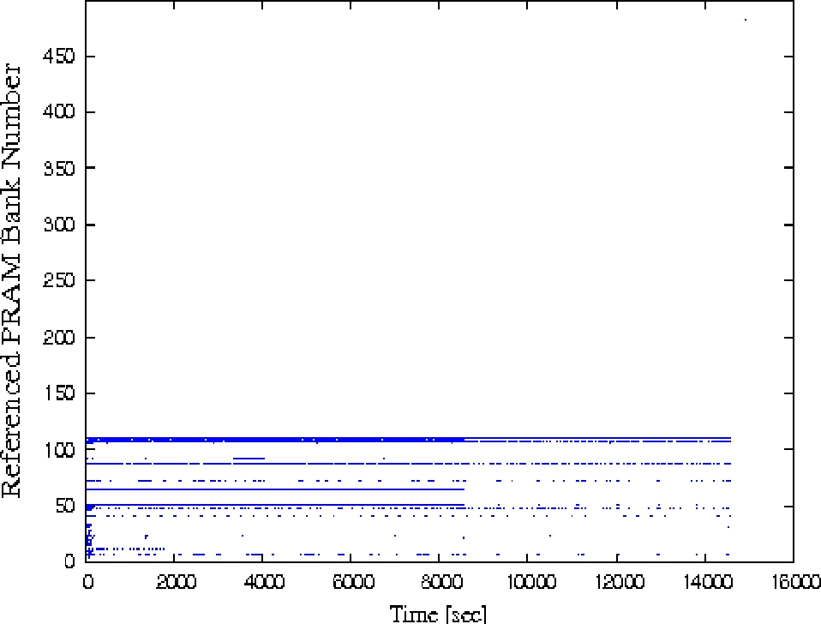
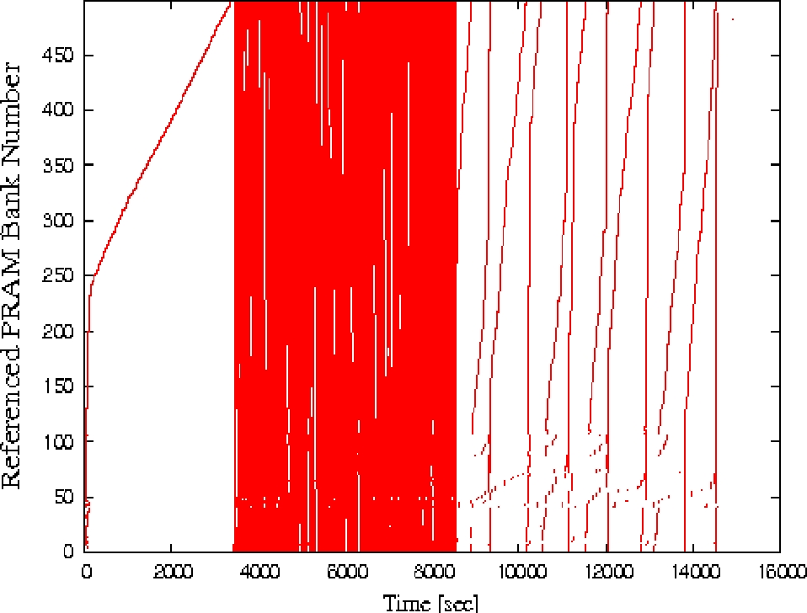
Wear-leveling Effect
Before Wear-leveling
After RR Wear-leveling
Heavily biased
resource usage
Balanced
resource usage
Notes:
For making the imbalance of plane utilization manifest, we reconfigured the capacity of each plane to 2MB while other configuration remains unchanged.
PSDSim reports that only small numbered planes are used with the same trace.
Because this imbalance is not desirable to write endurance, storage designer can have a question how simple round-robin based wear-leveler affect to eliminating the bias.
PRISM can answer this question as well. After applying RR wear-leveling, we can see the bias has been disappeared.
The algorithm of this wear-leveling scheme used can be found at our paper.

Slide 25
PRISM Overhead
PRISM’s I/O performance impact
  We ran IOzone benchmark with 200MB (HDD-friendly) sequential file write operations
3.5x slowdown
Notes:
Lastly, we measured how much PRISM incur system overhead.
Since backend simulator can be offloaded, we measured the overhead of PRISM frontend tracers in full-tracing mode.
This graph shows the speed normalized to PRISM with performing 200MB sequential file write with Iozone benchmark.
First, let us take a look at the comparison of PRISM speed over raw tmpfs without PRISM.
As you can see, PRISM incurs 3.5x times slowdown. However, this can be acceptable.

Slide 26
PRISM Overhead
PRISM’s I/O performance impact
  We ran IOzone benchmark with 200MB (HDD-friendly) sequential file write operations
11.5x faster
Notes:
When we compared to the case that performs the file write operations into HDD, PRISM speed is much faster than that as much as 11.5 times. In addition to running speed, PRISM can observe the byte-granule storage activities which HDD cannot support.

Slide 27
PRISM Summary
Versatile tool to study PRAM storage system
  Study interactions between storage level interface (programs/OS) and PRAM device accesses
  Run a realistic workload fast
  Extendible with user-defined tracer easily
  Explore internal hardware organizations in detail
Notes:
In this work, we introduce very versatile tool called PRISM which enable us to study the implications of new storage device built with emerging PRAM technologies.
With PRISM, storage designer can study the interaction between OS storage software stack and low-level PRAM device accesses in one place.
Also, PRISM can run a realistic large workload fast, and has a flexible interface for extension with user-defined tracers.
On top of that, the backend simulator allows storage designers to explore the internal hardware organization in details.
We believe that PRISM can be used by storage designers to understand the impact of PRAM storage device on the future system.
Finally, we would like to inform that we are planning to post our tool on the WEB soon.

Slide 28




Thank you !

