Slide 1
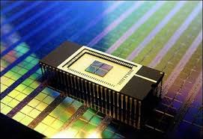
Memorage: Emerging Persistent RAM based Malleable Main Memory and Storage Architecture
Juyoung Jung and Sangyeun Cho
Computer Science Department
University of Pittsburgh

Slide 2
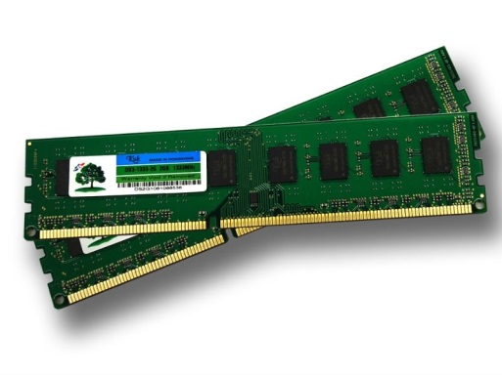
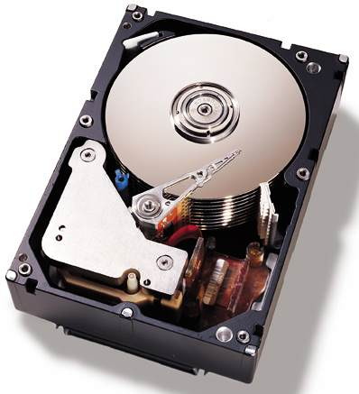
Introduction
Conventional memory hierarchy
DRAM
Main Memory
Secondary Storage
HDD

Slide 3
Introduction
Conventional memory hierarchy
DRAM
High performance
Low cost per bit
Scaling
Power consumption
Slow performance improvement
HDD

Slide 4
Emerging Persistent RAMs (PRAM)
 | Properties | Design Implications
 | Scalable | Higher density
 | Energy efficient | Energy saving
 | Byte-addressable | Main memory
 | Persistent | Secondary storage
 | Slower | Architectural support needed !
 | Imbalanced Read/Write
 | Limited cell endurance
1
2
(PRAM Storage Device)

Slide 5
Outline
Introduction
PRAM-based System Model
Memorage Architecture
Experimental Results
Conclusion

Slide 6
Future PRAM-based System Model
Main
Memory
PRAM
CPU
(SLC)
Memory Bus
PSD
Secondary
Storage
(MLC)
Legacy I/O interface via
Platform Controller Hub
Easy adoption without big change
Familiar dichotomized memory hierarchy concept

Slide 7
Problem of Memory Pressure
Ever-growing memory demands
Main
Memory
PRAM
CPU
Memory Bus
Memory Pressure
PSD
Secondary
Storage
Legacy I/O interface via
Platform Controller Hub
Severe performance degradation during page swapping operation

Slide 8
Outline
Introduction
PRAM-based System Model
Memorage Architecture
Objective and observations
Memorage approaches
Design and implementation
Experimental Results
Conclusion

Slide 9
Memorage Architecture
Objectives
Effective handling of memory pressure
Extending system lifetime
System-level observations
Little characteristic distinctions between main memory and storage resources (both are PRAMs)
Reducing I/O software overhead becomes more important than in the past
Storage density grows exponentially but the available storage capacity underutilized

Slide 10
Outline
Introduction
PRAM-based System Model
Memorage Architecture
Objective and observations
Memorage approaches
Design and implementation
Experimental Results
Conclusion

Slide 11
Memorage Architecture
Flexible resource sharing
Cross the traditional memory hierarchy boundary
Memorage approaches
Don’t swap, give more memory
Under high memory pressure, borrow PRAM resources from PSD to cope with the memory deficit
Don’t pay for physical over-provisioning
Excess PSD resources provide a system with “virtual” over-provisioning

Slide 12
Memory subsystem
OS VM manger
Memory Pressure
Step1-1
Step2
case(a)
Memorage Resource Controller
Memorage system
Okay! I have some to lend
Step2
case(a)
Step1-2
Storage subsystem
PSD
device driver
File system

Slide 13
Memory subsystem
OS VM manger
Do swap and
Page reclamation
Memory Pressure
Step1-1
Step2
case(b)
Memorage Resource Controller
Memorage system
Sorry! I have a tight budget
Step1-2
Storage subsystem
PSD
device driver
File system

Slide 14
Outline
Introduction
PRAM-based System Model
Memorage Architecture
Objective and observations
Memorage approaches
Design and implementation
Experimental Results
Conclusion

Slide 15
Key Design Goals
Transparency to existing applications
Avoid re-compiling applications
Manageable required system changes
Fast adoption of Memorage architecture
Extensive reuse of existing VMM infrastructures
Low system overhead
Keep users oblivious to Memorage support

Slide 16
Managing Resource Information
Reuse memory hot-plug feature !!
detected during boot process
1. PSD resource detection
Physical PSD PRAM
chunk0
chunk1
chunkN
node
from PSD
DMA
MEMORAGE
2. Building PSD resource data structures
DMA32
NORMAL
from main memory
zone

Slide 17
Managing Resource Information
3. PSD resource transfer
Physical PSD PRAM pages
chunk0
chunk1
chunkN
Filesystem
manipulation
MEMORAGE
zone

Slide 18
File system Metadata Exposure
On-disk layout of ext3 file system
Boot block
Block group 0
Block group 1
···
Block group n
Super block
Group descriptors
Data
bitmap
Inode
bitmap
Inode
table
Data
blocks
Exposed to Memorage manager
Example of data bitmap change on storage capacity donation
(4MB donation assuming 4KB data block size)
···
Zone
Memorage
···
···
1111111 0000000000 00110
···
1111111 1111111111 00110
···
···
Buddy allocator including new zone Memorage

Slide 19
Memory Expansion and Shrinkage
Total size
zone balanced
kswapd sleep
Available MM pages
kswapd woken up
pages_high
1
pages_low
pages_min
time
Additional
Memorage pages
expanded margin
new pages_high
new pages_low
With Memorage, never reach to watermark to invoke kswapd in this case
2
new pages_min

Slide 20
Outline
Introduction
PRAM-based System Model
Memorage Architecture
Experimental Results
Conclusion

Slide 21
Evaluation Methodology
Performance evaluation
Measure the performance improvement with a prototype system implemented in Linux
Emulate future platform with NUMA system

Slide 22
Emulation Methodology
Memory pressure
Offloading PSD resources
CPU #0
(4 cores)
CPU #1
(4 cores)
Memorage performs hot-plug PSD resources
4GB
Socket 0 memory
96GB
Socket 1 memory
Main memory
Emulated PSD

Slide 23
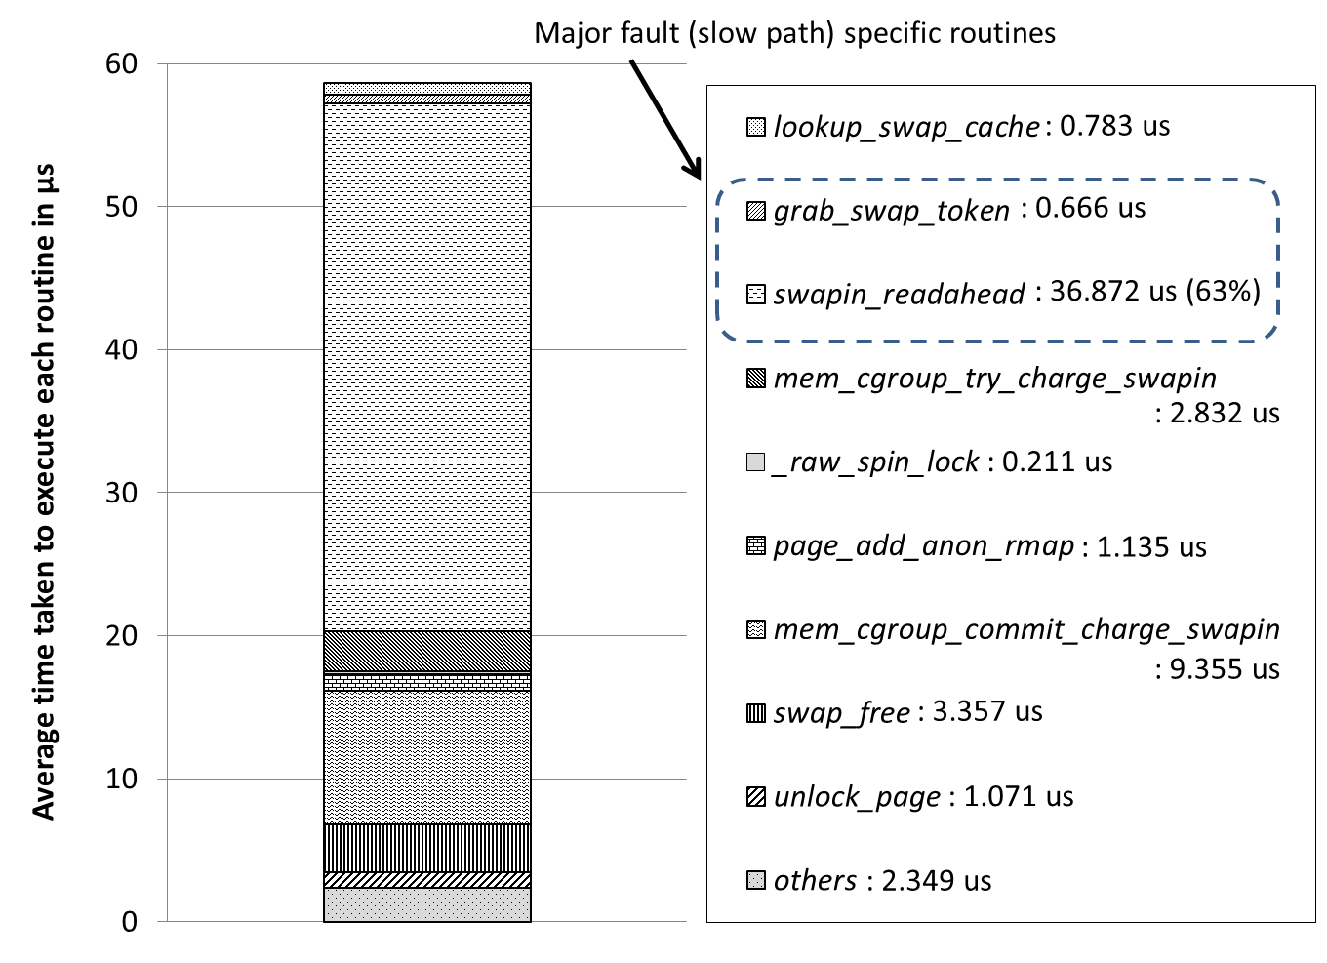
OS Latency for Page Fault Handling
58.6 us
21.6 us

Slide 24
Evaluated Memory Configuration
Workload
8 memory-intensive benchmarks from SPEC CPU2006
Aggregate memory footprint is 5.6GB
(bwaves, mcf, milc, zeusmp, cactusADM, leslie3d, lbm, GemsFDTD)
Memory configurations
Baseline: 4.4GB effective memory capacity available
Memorage: with additional 2GB capacity from PSD, total 6.4GB effective memory capacity available

Slide 25
Exec. Time Breakdown (Baseline)

Slide 26
Exec. Time Breakdown (Memorage)

Slide 27
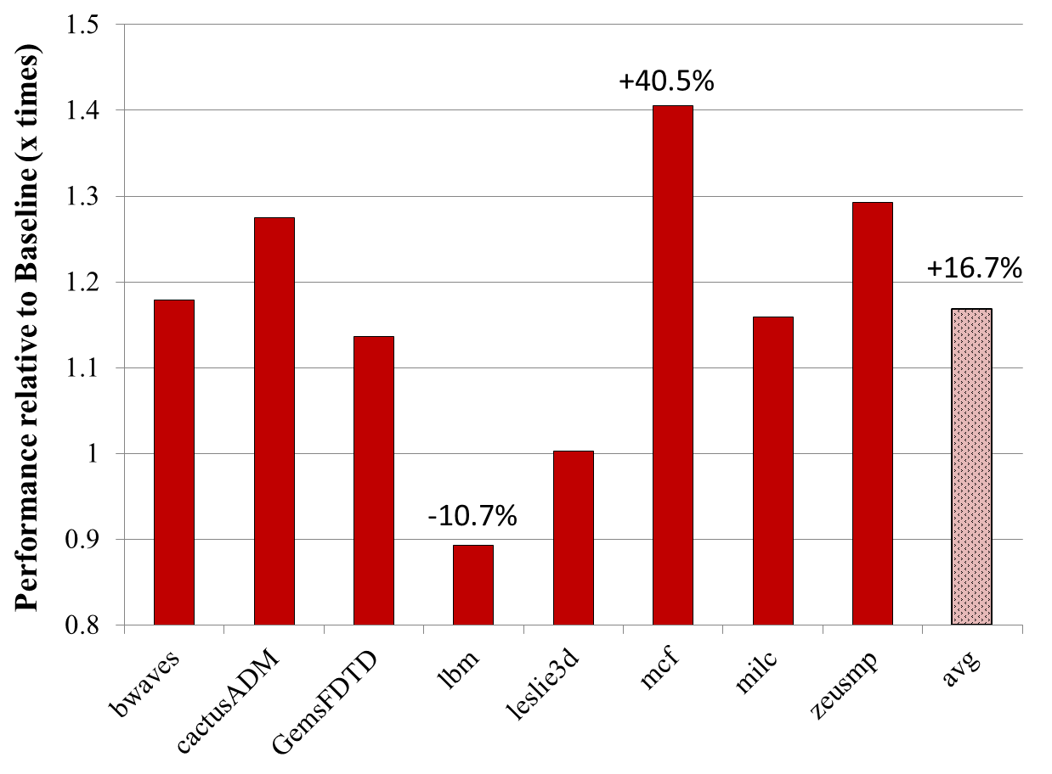
Relative Performance of Benchmark
dynmic

Slide 28
Lifetime Evaluation
Analytical model for lifetime analysis
Variable | Description
L_{m} , L_{s} | lifetime of main memory(MM) and PSD
C_{m} , C_{s} | capacity of MM and PSD
E_{m} , E_{s} | write endurance of MM and PSD
D_{m} , D_{s} | total data volume of MM and PSD before the first failure D_{m} = E_{m} ∙ C_{m} , D_{s} = E_{s} ∙ C_{s}
B_{m} , B_{s} | average data update rate or write data band width
α , β, ϒ | C_{m} = α ∙ C_{s} , B_{s} = β∙ B_{m} , E_{m} = ϒ ∙ E_{s}
h | η / C_{m} , where η is the transfer size

Slide 29
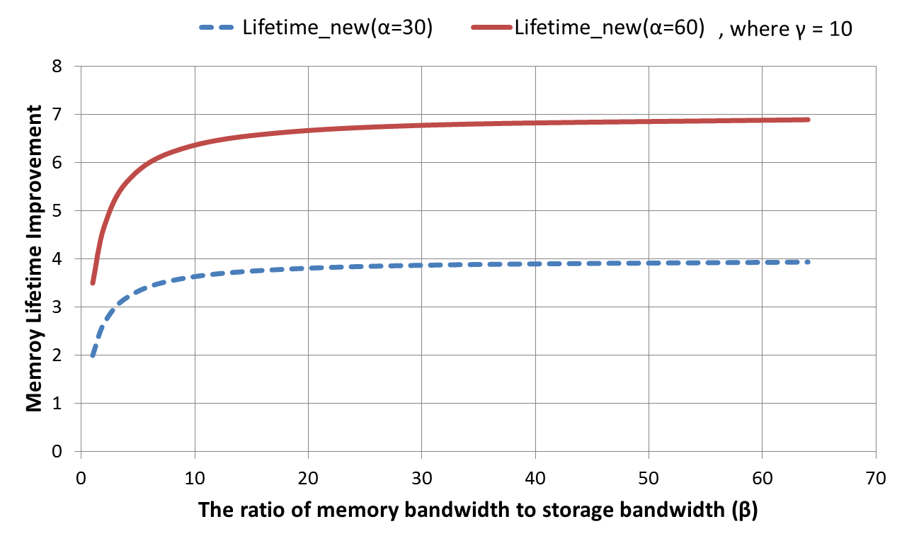
Main Memory Lifetime Improvement
8GB MM + 240GB PSD
8GB MM + 480GB PSD
endurance ratio fixed
rapidly reaches a maximum lifetime even with small bandwidth ratio
Since realistic write bandwidth of main memory is much larger than PSD, achieve large main memory lifetime improvement !!
variables

Slide 30
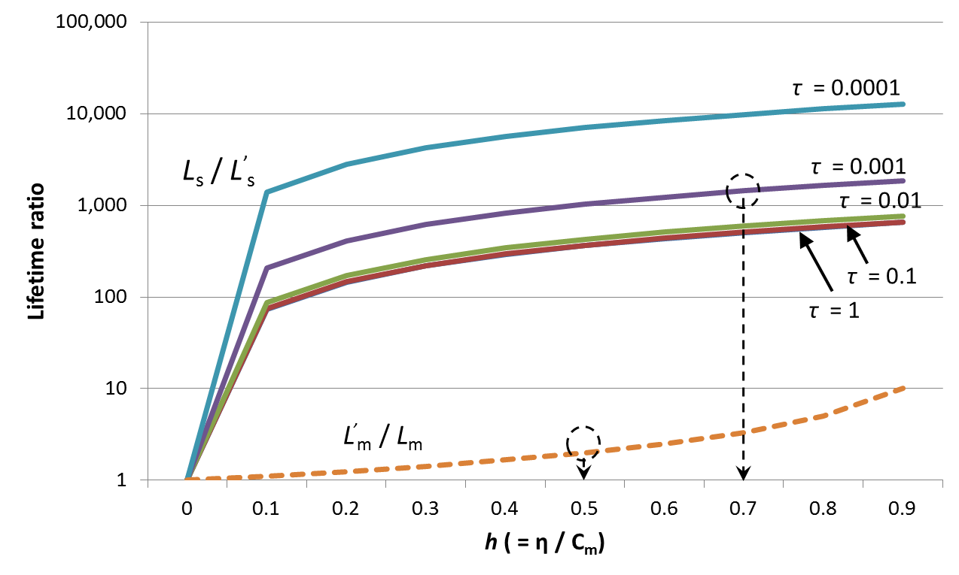
System Lifetime
PSD lifetime from 10,000 years to 10 years
Main memory lifetime from 2.5 year to 5 years
2x memory lifetime improvement
1000x PSD lifetime degradation
ratio of the donated PSD capacity to memory capacity
E_{s} = 10⁵, E_{m} = 10⁶, B_{m} = 100MB/s

Slide 31
Outline
Introduction
PRAM-based System Model
Memorage Architecture
Experimental Results
Conclusion

Slide 32
Conclusion
Memorage architecture
Capacity sharing across the conventional memory and storage boundary
Better handle memory pressure by exploiting excess PRAM resources from PSD
System performance improvement up to 40.5%
Better utilize available system PRAM resources to improve main memory lifetime
System lifetime enhancement up to 6.9 times

Slide 33
Thank you for listening!

