Slide 1
Bio
Michel Hanna
M.S. in E.E., Cairo University, Egypt
B.S. in E.E., Cairo University at Fayoum, Egypt
Currently is a Ph.D. Student in Computer Engineering Program, University of Pittsburgh
Notes:
Hi, I am Michel Hanna I have M.S. …..

Slide 2
CHAP: Enabling Efficient Hardware-based Multiple Hash Schemes for IP Lookup
Michel Hanna
Socrates Demetriades
Sangyeun Cho
Rami Melhem
Notes:
- I am going to present today “CHAP” which is a hash-based solution for IP lookup.
- This work was done by me and my college Socrates and both my advisors Dr. Melhem and Dr. Cho (go to next)

Slide 3
The Problem
user
server
you
router
router
YouTube Server
Internet
user
server
user
Notes:
When you request a video clip from YouTube a stream of packets will be exchanged between your PC/laptop and the server as we can see (PUT ANIMATION).
The speed of those packets depends on two factors:
1- The bandwidth of the links (PUT ANIMATION) which is already growing up
2- the Internet’s routers’ packet processing speed (PUT ANIMATION) which will be our focus today (go to next)

Slide 4
Inside a Router
Prefix | Port N#
0* | 0
1* | 1
100* | 6
1000* | 4
100000* | 3
101* | 2
110* | 1
11001* | 5
111* | 3
Link
Link
Output Port
Input Port
YouTube
Forwarding Table
Input Port
CA
Output Port
.
.
.
.
.
.
.
.
.
.
.
.
.
.
.
.
.
.
.
.
.
.
.
.
Forwarding Decision
Switching Fabric
Hotmail
Aachen
Output Port
Input Port
Notes:
The router is a special computer that routes packets between the network nodes.
The hardware switching fabric is controlled by the forwarding decision controller which has to consult the IP forwarding table.
(PUT ANIMATION) The IP forwarding table (also IP lookup table) stores for each IP address prefixes which port to send packet to.
The IP prefix consists of 1, 0, and wildcards and when we match the address we seek the Longest prefix.
These tables are growing in size very fast and we need to store them efficiently to keep up with the links speed(go to next)

Slide 5
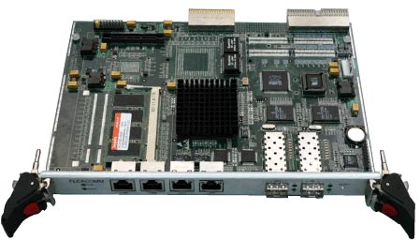
Current Solution
the TCAM (Ternary Content Addressable Memory):
the most usable solution in real life as it provide the answer in single memory access
However:
very high power consumption
very low bit density & not scalable
run at lower speed than RAMs
Prefix | Port N#
0* | 0
1* | 1
100* | 6
1000* | 4
100000* | 3
101* | 2
110* | 1
11001* | 5
111* | 3
TCAM
Notes:
TCAM is the most useable solution in commercial routers.
It’s a special type of memory where hardware does the comparison at every memory cell.
(PUT ANIMATION) It’s just a table that we scan all of it for every packet.
it has a lot of issues … (go to next)

Slide 6
Hash-based solution
Prefix | Port N#
0* | 0
1* | 1
100* | 6
1000* | 4
100000* | 3
101* | 2
110* | 1
11001* | 5
111* | 3
L = bucket size
RAM
N = n# rows
Prefix_{i}
h(.)
Hash function
The Overflow
How to handle the OVERFLOW?!
Notes:
Hashing is well know method to store large sparse tables in efficient spaces.
For example, we take this table and (PUT ANIMATION) apply hash function to each prefix to point exactly which row it’s stored in.
(PUT ANIMATION) how many prefixes we can store in each row is limited by “L” the bucket size (row width)
In real life (PUT ANIMATION) we are faced by this situation where we have overflow
Our main concern (PUT ANIMATION) will be how to handle this overflow (go to next)

Slide 7
Use Linear Probing…
we might scan the entire table…
Prefix_{i}
h(.)
hash function
means that we can’t bound memory access time …
Notes:
How we handle the overflow (PUT ANIMATION)
We try to store it in the first available slot as we see.
This is called “linear probing” which is not good because in the worst case we might have to scan the entire table.
imagine that magically at the end of each row you have someone to tell you where to look next.
And this is exactly what CHAP (our solution) does (go to next)

Slide 8
Content-based HAsh Probing
β₀[h()]
β₁[h()]
Prefix_{i}
h (.)
hash function
Probing Pointers
Note that the probing pointers are set differently for each IP lookup table based on its content
Notes:
CHAP stands for “Content-based HAsh Probing”
And here how it works: (PUT ANIMATION)
If you try to insert a prefix here at this row and could not, then you try the next row (in blue) via the Beta zero Probing Pointer, if not then try the green …
The probing pointers are set differently for each IP lookup table based on its content. (got to next)

Slide 9
Evaluation
we used simulation to validate our scheme on real life IP lookup tables
14 tables from different systems were used and all gave the same results
quality is measured in terms of “overflow”:
percentage of prefixes that did not fit in the hash table…
 | N# of Tables | Ave. Size (K)
rrc04 | 3 | 185
rrc05 | 4 | 179
rrc07 | 3 | 133
rrc11 | 4 | 198
Notes:
Simulation
14 real tables size is 174K on average
Overflow will be our metric …

Slide 10
CHAP v.s. Linear Probing
Legend
L: Bucket or row width
N: Number of rows
m: Number of probing pointers for CHAP and the number of probing steps for the linear probing
C_{i}: Configuration number ‘i’
still some overflow?
Notes:
- The improvement is up to 85% in the practical region which lies between 2 and 6 accesses.
More improvement can be achieved but we need to be in this region
(PUT ANIMATION) However, we still have some overflow left here as we can see (go to next)

Slide 11
still have some overflow left…
Use Multiple Hashing…
the prefix might go to one of the two buckets…
Prefix_{i}
h₀(.)
h₁(.)
Multiple hash functions
We combine CHAP with Multiple Hashing
Notes:
Another way is to use multiple hash functions which is known to reduce the overflow better than linear probing.
If the prefix could not fit in a certain bucket using h0() we try h1(). (PUT ANIMATION)
However (PUT ANIMATION) we still have some overflow left (smaller than before).
Using more hash function will not resolve all the overflow however it will increase the memory access time
This is why we combine CHAP with multi-hashing (go to next)

Slide 12
CHAP(H, m)
Number of Probing Pointers
Number of Hash Functions
β₀[h₀()]
β₁[h₁()]
Prefix_{i}
h₀(.)
h₁(.)
multiple hash functions
use multiple hash functions
Probing Pointers
Notes:
Here we use multiple hash functions (PUT ANIMATION) to reduce the overflow
Then we apply CHAP to reduce it even more (PUT ANIMATION)
We call it CHAP(H, m) where H = number of hash functions and m = number of probing pointers

Slide 13
CHAP(H,H) vs. Multiple Hashing (MH): Overflow
We experiment with m = H
Notes:
We can see that we outperform MH and that the best result is at bucket size L = 100 where we store more than 10% of prefixes than MH which is around 17K prefixes more
fair comparison: we compare both CHAP(H,H) and MH(2H) under the same worst-case memory access time.
In general “overflow reduction ➔ translates to ➔ storing more prefixes in the hash table.
-
(if they ask about the remaining overflow say we add it to the overflow buffer which could be small TCAM)

Slide 14
Search in Set-Associative Arch.
…
RAM
IP Address
IG
N
All keys in one row are matched in parallel
Consumes “1/N” of TCAM power
Matching Processors
MP
MP
MP
MP
…
MP
Parallel Matching
One Cell
Priority Encoder
Prefix
Len
Port
Result
Notes:
(PUT ANIMATION) Upon receiving a packet, the Index Generator (IG or the hash function) computes which row we can try to find the prefix that might match this packet.
in the next cycle (PUT ANIMATION) and after pulling down this entire row, we use the Matching Processors to obtain the possible matches
In the third cycle (PUT ANIMATION) we use the Priority Encoder to find the Longest Prefix Matching this packet.
Note that all the keys are matched in parallel ➔ they require one memory cycle
Also that we roughly consumes (1/N) of TCAM power.

Slide 15
CHAP vs. MH: ASST
(Average Successful Search Time)
Notes:
Here we define a new metric which is the Average Successful Search Time (ASST) which indicates how fast we are compared to MH.
We might need to access the memory several times because we of the multiple hash functions and multiple probing pointers
On the average we have a smaller ASST by 2.2% as we slightly outperform MH nearly in all cases except where L = 100 where we are 0.05% less than MH however and as we said we store 10% more than MH (17K prefixes more)

Slide 16
Tradeoff between Overflow and ASST
Overflow
Curve # 2
Curve # 1
Better scheme
ASST
Notes:
In a hashing system, if this is the ASST and this is the Overflow, then we are faced in the real life with this trade-off (PUT ANIMATION)
Low overflow ➔ More probing (or hash functions) ➔ Higher ASST
Lower ASST ➔ larger overflow
It’s desirable to have both Lower overflow and lower ASST (PUT ANIMATION)

Slide 17
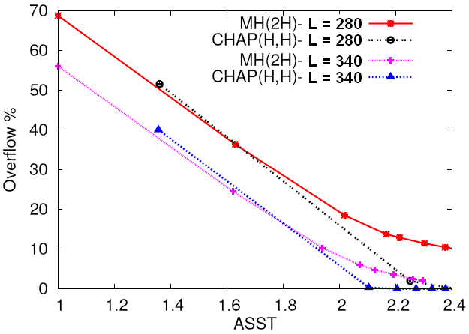
Tradeoff between Overflow and ASST
Notes:
At this point (ASST = 2) the CHAP has a better overflow than MH for these two cases where L = 280 and 340 respectively
Note that CHAP was able to eliminate the overflow in both cases without increasing the ASST

Slide 18
Conclusion and Future Work
CHAP is effective in:
reducing the overflow by 72% on average compared to other probing schemes
low average memory access time (2.5 accesses max)
apply it to other network applications:
packet filtering, packet inspection, VPN packet forwarding … (future work)
study the general case ``CHAP(H,m)’’ with “H ≠ m”
may be useful for other applications (speech recognition…)

Slide 19
Thank you
Questions?

Slide 20
Backup slides

Slide 21
The CA-RAM Architecture
L = bucket width
…
RAM
Key
IG
N = n# rows
Index Generator
Matching Processors
MP
MP
MP
MP
…
MP
One Cell
Parallel Matching
Prefix
Len
Port
Priority Encoder

Slide 22
Search in CA-RAM
this row where the prefix is stored
…
RAM
IP Address
IG
Matching Processors
MP
MP
MP
MP
…
MP
Parallel Matching
One Cell
Priority Encoder
Prefix
Len
Port
Result

Slide 23
CHAP Setup Algorithm
The goal is to map lookup table into a hash table with 2^{R} = N rows
R = n# of bits used to index the hash table
first sort prefixes from long to short then we collect stats about the lookup table:
calculate the n# of prefixes to be assigned to each row
Notes:
Extra slides

Slide 24
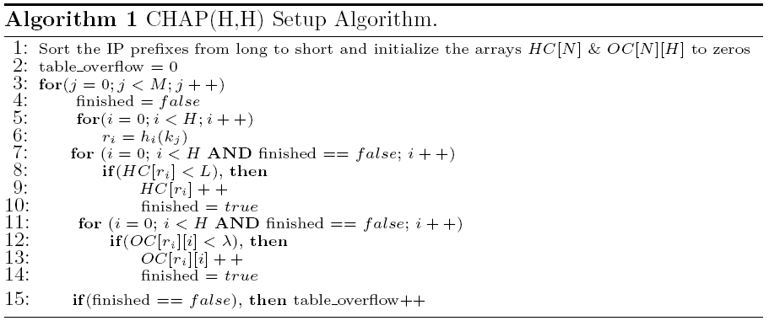
CHAP Setup Algorithm

Slide 25
CHAP Setup Algorithm
When Algorithm 1 exits, “table_overflow” contains the n# of prefixes that could not fit
if not acceptable, then the algorithm repeated with more hash functions
a separate TCAM is used to store the short prefixes and the overflow
Activating the probing pointer’s array is done by running the best fit algorithm
Notes:
Activate; to assign values to the probing pointer’s array

Slide 26
Search in CHAP
the order of accessing the probing pointers used in searching has to be the same order used in inserting the prefixes:
This constraint has to be satisfied to guarantee the LPM
the order is maintained by dedicating one probing pointer per hash function

Slide 27
The Incremental Updates
we need to define where to store the new prefix (k_{n}) according to its length to achieve LPM
if the prefix already exists then the existing entry will be updated
based on the length of k_{n} relative to the lengths of both k_{l} and k_{s}, we will try to insert k_{n} in one of the 2×H rows generated by the hash functions and the probing pointers

Slide 28
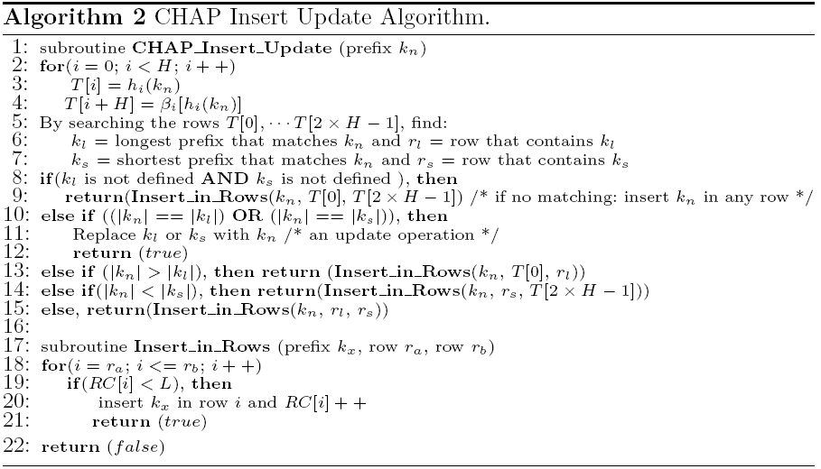
The Incremental Updates

Slide 29
The Incremental Updates
the subroutines terminate successfully if we were able to insert k_{n} successfully
Otherwise, we should either insert kn into the auxiliary TCAM,
or try using backtracking scheme like “Cuckoo hashing”
replace an existing prefix (k_{y}) from the hash table by k_{n}
try to reinsert k_{y} into the hash table recursively

Slide 30
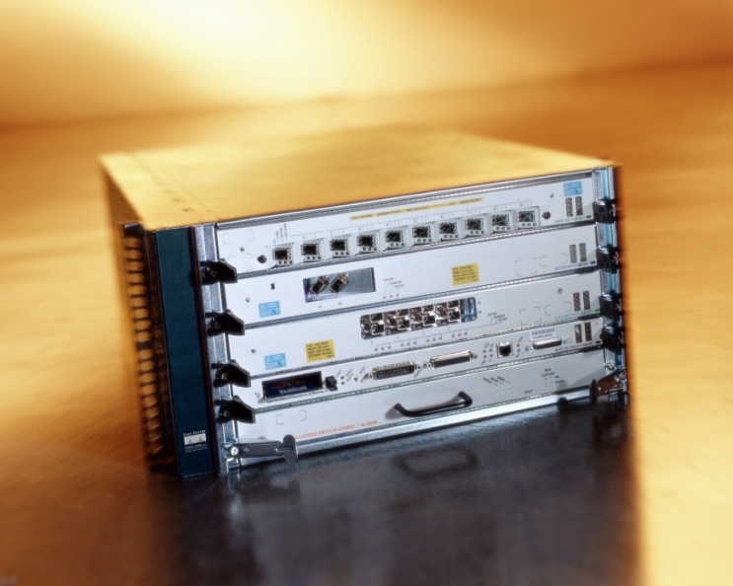
Formal problem definition
internet routers require wire speed packet forwarding while sizes of the IP lookup tables are increasing
near future: “Terabit” link rates will be available with affordable prices
need scalable solution that fits our current needs, and future needs

Slide 31
Hash-based solution
hardware realization of hash table!
it directly addresses the all severe shortcomings of the TCAM as it uses RAM:
High bit density and very scalable
Low power consumption
however:
hard to handle the overflow
no bound on the memory access time
Notes:
Memory access time can’t be bounded in case we want to fit the entire IP lookup table in a single hash table
- There are few available examples of such architecture: 1- CA-RAM 2- IP-STASH

Slide 32
CHAP vs. Multiple Hashing - Overflow
overflow comparison between the CHAP(H,H) and MH(H) for H = 1 to 4 and for the same loading factor (RAM table aspect ratio)

Slide 33
CHAP vs. Multiple Hashing - ASST
ASST comparison between the CHAP(H,H) and MH(H) for H = 1 to 4 and for the same loading factor (RAM table aspect ratio)

Slide 34
Content-based Hash Probing
notice that some rows incur overflow while others have space
can keep some bits at the end of each row that work as pointers to rows that have empty space

Slide 35
Search in CHAP
the underlying architecture reads a full row of the table into a buffer in one clock cycle
uses parallel matching processors to determine the match if any in that bucket
we measure the quality of the search in: Average Successful Search Time (ASST)
Ave. n# rows accessed for successful search

