Slide 1
Predicting Coherence Communication by Tracking Synchronization Points at Run Time
Socrates Demetriades and Sangyeun Cho
45th International Symposium in Microarchitecture, December 2012

Slide 2
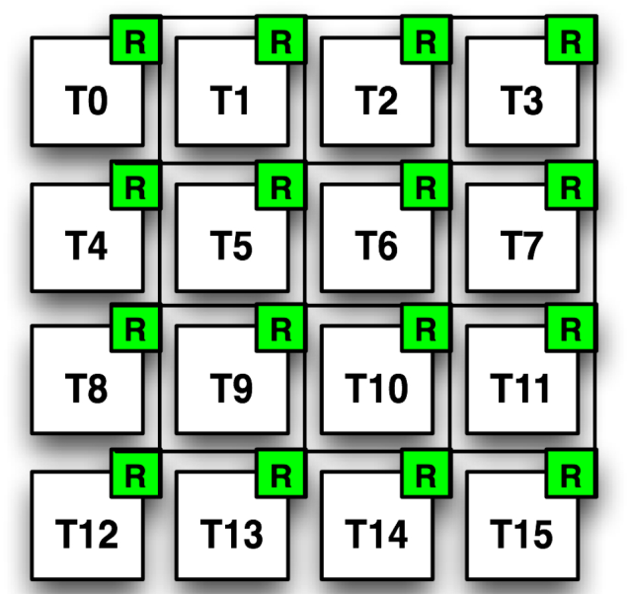
Coherence Communication
The result of data sharing between threads, when those run on a shared memory multiprocessor with coherent private caches.
Block A exclusive to T0
T13: Request to share A
T13 “communicates” with T0.
Block A is copied to T13.
A
A
Miss
[Shared Memory Model / Write-Invalidate Coherence Protocol]

Slide 3
Coherence Communication
Block A is shared.
T13: Request for exclusive ownership.
T13 “communicates” with T0 & T6.
Invalidate copies.
A
A
A
Upgrade
Communicating Misses: all request that must communicate with at least one other core.
[Shared Memory Model / Write-Invalidate Coherence Protocol]

Slide 4
Communication Overheads
Directory-based Coherence Protocol
Snoop-based Coherence Protocol
A
A
A: T0
A
A
Miss
Miss
Indirect Miss to the Directory
=> Increase Miss Latency
Broadcast to all
=> Increase traffic

Slide 5
Communication Prediction
A
A: T0
Trade-Off
Accuracy vs Extra traffic
A
Miss
Predict

Slide 6
Traditional Prediction Approaches
Simple temporal-based prediction.
- Locality between consecutive misses.
ADDRESS-based prediction.
- Locality based on the address of the request.
INSTRUCTION-based prediction.
- Locality based on the static store/load instr.
A
ADDR | PREDICTOR
A | [T0, … ]
Miss
INST | PREDICTOR
{LD} | [T0, …]
# access addresses
# static LD/SRs
PREDICTOR
[T0, …]

Slide 7
Contribution of this work
Synchronization Point based Prediction (SP-prediction)
Inter-thread communication caused by coherence transactions is tightly related with the synchronization points in parallel execution
Main Idea: Associate the communication behavior with synchronization points and utilize this association to predict the destination of misses.
Main Advantage: Has very low storage cost, yet delivers relatively high performance.

Slide 8
Outline
Introduction
Motivation & Observations
SP-Prediction
Evaluation
Conclusion

Slide 9
Why Synchronization Points?
BARRIER
LOCK
UNLOCK
BARRIER
SIGNAL
Core 1
Core 2
Core 3
Core 4
WAIT
shared data
communication direction
[Pthread notation]

Slide 10
Synchronization Epochs
SYNC-POINT A
SYNC-POINT B
SYNC-POINT C
SYNC-POINT D
SYNC-POINT E
Core 0
Sync-epoch A
Sync-epoch
B
Sync-epoch
C
Sync-epoch D
Communication Distribution of Core 0 (full interval)
Communication Distribution of Core 0 (different sync-epochs)
# contacts
Destination Core ID
Destination Core ID
[Benchmark: Bodytrack / 16-threads]

Slide 11
Sync-Epoch Dynamic Instances
SYNC-POINT A
SYNC-POINT B
SYNC-POINT C
SYNC-POINT D
SYNC-POINT E
Core 0
Communication Distribution of Core 0 (same sync-epoch in different dynamic instances)
# contacts
A
B
A
B
A
B
A
B
Core 0
Destination Core ID
[Benchmark: Bodytrack / 16-threads]

Slide 12
Outline
Introduction
Motivation & Observations
SP-Prediction
Evaluation
Conclusion

Slide 13
SP-prediction – Overview
Monitor destinations of each miss on each core.
Extract communication signatures for each sync-epoch.
Store and later reuse those signatures to predict misses in future sync-epoch instances.
When initial predictions do not exist or are inaccurate, reconstruct the signatures within the sync-epochs.
Sync Points must be exposed to the hardware so it can sense the beginning and end of sync-epochs.
A dedicated instruction must be inserted at the calling location of the synchronization point.
PC, lock variable and type must be extracted and pass to a history table.

Slide 14
SP-prediction: History-based
SYNC-POINT A
SYNC-POINT B
SYNC-POINT A
SYNC-POINT B
CORE 0
Track
Communication
A
C0 | C1 | C2 | C3
Extract Hot Commun.Set
A
[hot comm. set ]
Store to SP-table
SP-TABLE
Sync-Point PC | PREDICTOR
A | [hot comm. set ]

Slide 15
SP-prediction: History-based
SYNC-POINT A
SYNC-POINT B
SYNC-POINT A
SYNC-POINT B
CORE 0
Miss
Retrieve hot core set
SP-TABLE
Sync-Point PC | PREDICTOR
A | [hot comm. set ]
[hot comm. set ]

Slide 16
SP-prediction: History-based (for Locks)
LOCK A
UNLOCK B
CORE 0
Lock Release: Store Core Id
[C0]
SP-TABLE
LOCK ADDR | PREDICTOR
LOCK ADDR | PREDICTOR
A | [C0]

Slide 17
SP-prediction: History-based (for Locks)
LOCK A
UNLOCK B
CORE 0
LOCK A
UNLOCK B
CORE 0
Lock Acquire: Retrieve Predictor
SP-TABLE
LOCK ADDR | PREDICTOR
A | [C0]
[C0]

Slide 18
SP-prediction: First Sync-Epoch Instances
SYNC-POINT A
SYNC-POINT B
CORE 0
1st Instance
SP-TABLE
Sync-Point PC | PREDICTOR
Early Hot Set
No history exists for this point (first instance).
Allow some warm-up time and then extract an “early” hot communication set.
Use the set as a predictor for the rest of the interval.

Slide 19
SP-prediction: Adaptive Recovery
SYNC-POINT A
SYNC-POINT B
CORE 0
Miss
Miss
SP-TABLE
Retrieved Hot Set
New hot set
Sync-Point PC | PREDICTOR
A | [hot comm. set ]
Sync-point is detected, predictor is retrieved from SP-table
Start using predictor for each miss, with high confidence.
If prediction accuracy drops low, extract a new hot communication set on the spot.
Continue predictions based on the new predictor.

Slide 20
Why SP-prediction
In contrast to simple temporal prediction, it exploits application-defined interval-based communication localities.
No restricted on temporal locality among consecutive misses.
Can adapts faster to the changes.
Can recall old and forgotten communication patterns.
Compared to address and instruction based prediction, it has very low storage requirements.
SP table must holds, on average 5-30 static sync points for a given application.
Take advantage of the existing programming paradigm while being transparent to the programmer.

Slide 21
Outline
Introduction
Motivation & Observations
SP-Prediction
Evaluation
Conclusion

Slide 22
Evaluation Methodology
Simulated Machine Configuration (based on simics)
In order core
Private L1/L2
DIR slice.
Network logic
Coherence Logic
Workloads
From Splash 2 & PARSEC Suites.
# static sync-epochs: 5-30
# dynamic sync-epochs: 22-20,000 (for the evaluated input sizes)
SP-prediction implemented on top of Baseline Directory.

Slide 23
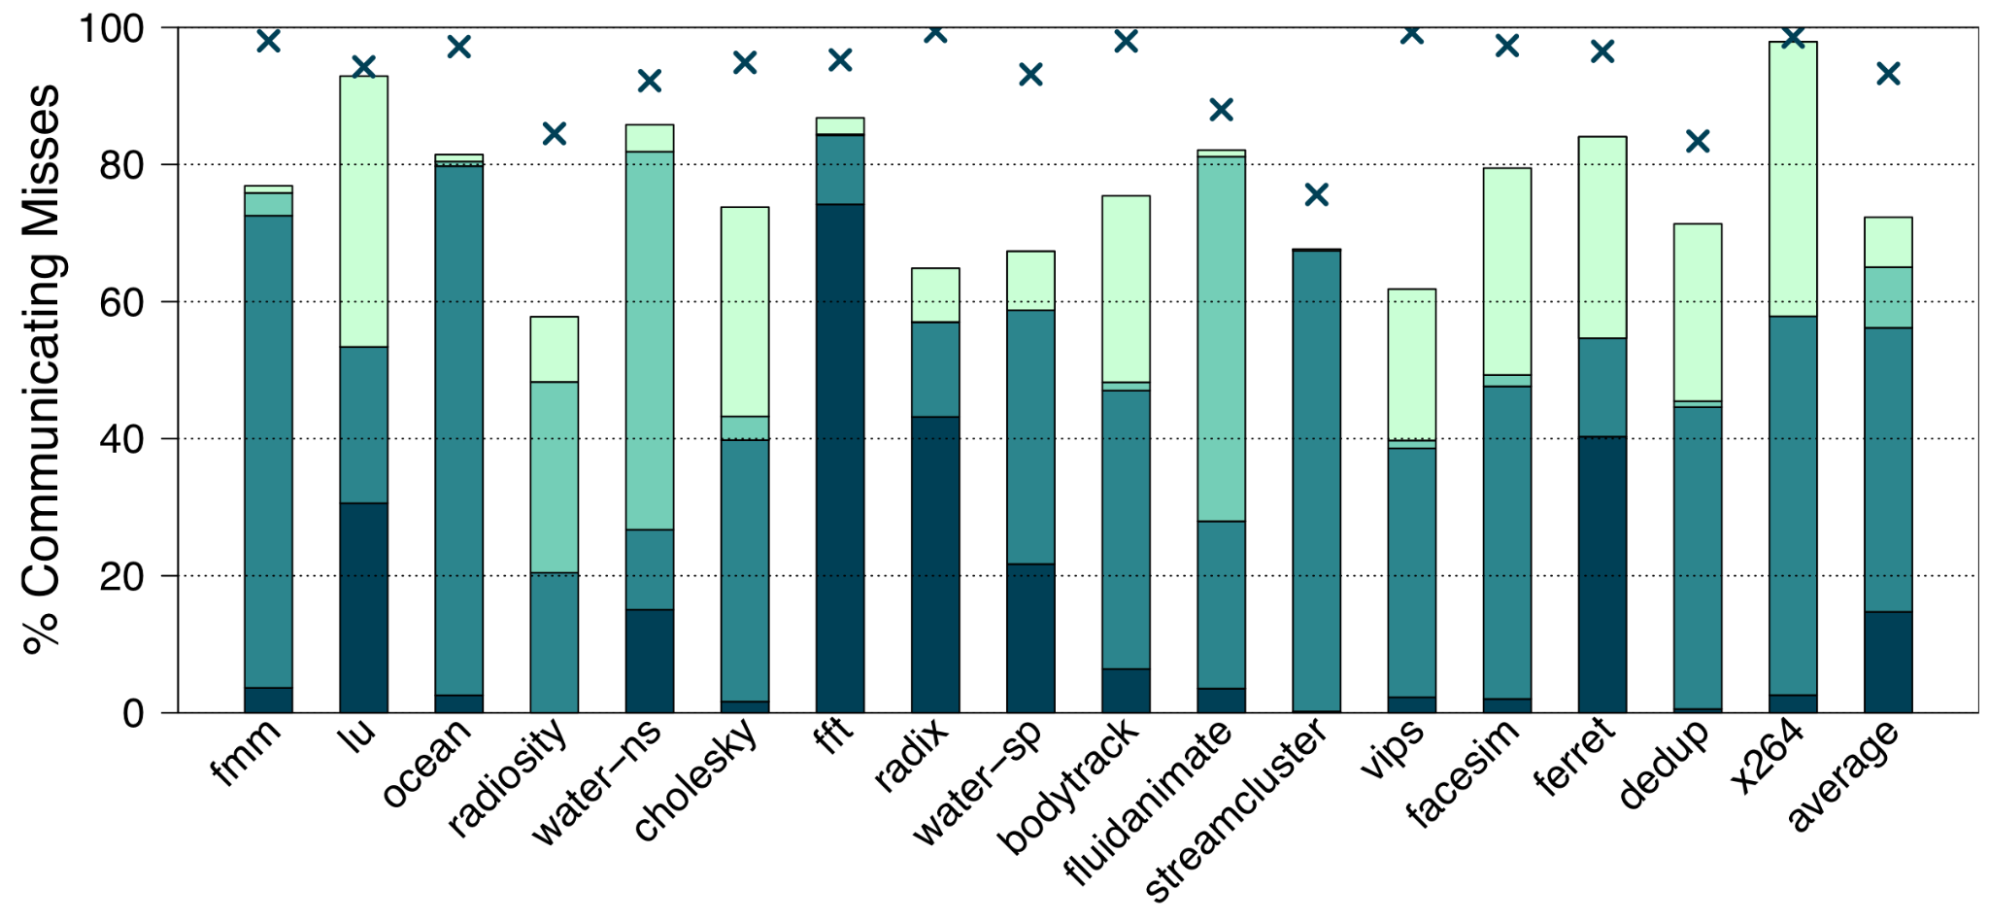
Prediction Accuracy
76%

Slide 24
Prediction Accuracy
76%
 | Average
Destination Set Size (actual) | 1.2
SP-prediction Set Size | 2.6

Slide 25
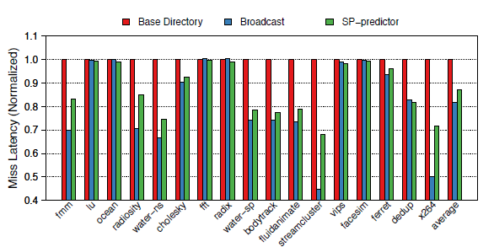
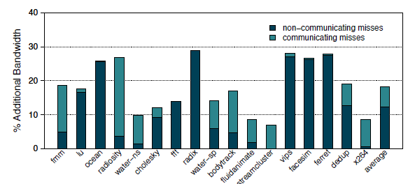
Results: Latency & Bandwidth
13%
Execution Time Improvements: 7% on average.
Additional Energy Dissipation: <7% (14% NoC, 9% cache lookups). (more than 90% lower compared to broadcasting)
18%
(5%)

Slide 26
Comparison with other Predictors
BEST POSITION

Slide 27
Comparison with other Predictors
PREDICTION TABLE STORAGE
INFINIT ENTRIES
BEST POSITION

Slide 28
Comparison with other Predictors
PREDICTION TABLE STORAGE
512 ENTRIES
BEST POSITION

Slide 29
Conclusions
SP-prediction is a new, run-time and application-driven approach on communication predictability.
Promotes very low storage requirements, an important property for emerging CMP implementations.
Scales independent of core count and cache sizes.
Takes advantage of the existing shared memory programming paradigm and current consistency models.

Slide 30
Thank you for your attention!
45th International Symposium in Microarchitecture, December 2012

Slide 32
Discussion
SP-table consumes considerably lower dynamic power than ADDR or INSTR tables.
accessed only on sync-points and not on each miss.
Thread migration support
By tracking “logical” destinations.
Projections for commercial workloads (show bars)
Critical Sections (unpredictable patterns) are effectively handled.
SP-prediction is not perfect
Coarse-grain sync-epochs may exhibit communication behaviors that change.
Very fine sync-epochs cannot give a good representative hot communication set.
Unless the sync-epoch is critical section, unpredictable patterns cannot be discovered.

