Slide 1
BarrierWatch: Characterizing Multithreaded Workloads across and within Program-Defined Epochs
Socrates Demetriades and Sangyeun Cho
Computer Frontiers 2011, Ischia, Italy.

Slide 2
Program’s time-varying behavior.
Bodytrack / 16-threads parallel execution
NoC Traffic
Time
Adaptive CMP architectures can take advantage of this time varying behavior.
Challenge: How to detect behavioral changes?

Slide 3
Tracking program behavior
Traditionally, two methods for tracking program phases
Run-time monitoring of the program execution.
Observations are limited by the monitoring metric.
Cost of monitoring mechanisms.
Granularity of monitoring intervals? Fine- vs coarse- grain?
Profile based analysis.
Static program analysis, complicated algorithms.
Binary rewriting
Architectural support.
Code-based metrics: not directly suitable for parallel workloads.

Slide 4
Overview of our proposal
View the program execution on ‘epoch’ granularity.
Track the program behavior at Run Time.
Effective
Simple
Low-cost
Notes:
Simple: No continues interval monitoring is required, no profile analysis and complicated algorithms.
Low cost: Requires minimal architectural support and no modifications to the application source code.

Slide 5
Outline
Introduction
Program epochs and characterization
Run-time epoch change detection.
Case study
Summary

Slide 6
Observation / Motivation
NoC Traffic
Time
Natural alignment of barriers with the changes in program behavior.
Intervals enclosed by barriers repeat with consistent behavior.
Notes:
Our proposal is motivated by a strong observation.
The vertical lines indicated the points in execution where the parallel threads of the program are globally synchronized, or in programming terms, the barrier points.

Slide 7
Program epochs
A
Barriers
NoC Traffic
epoch
B
Time
A
A
B
B
B
A
A
A
B
B
A
B
epoch
epoch
epoch
epoch
epoch
epoch
Epoch: An execution interval between two consecutive barriers.
Notes:
Based on the these observations, we propose a new, simple and more relaxed program behavior representation based on the what we call now “epoch” granularity.

Slide 8
Program epochs
A
Barriers
NoC Traffic
epoch
B
Time
BA
BA
BA
BA
BA
epoch
epoch
epoch
epoch
epoch
Epoch: An execution interval between two consecutive barriers.

Slide 9
Program epochs
NoC Traffic
Time
C
D
C
D
epoch
epoch
Epoch: An execution interval between two consecutive barriers.

Slide 10
Program epochs
NoC Traffic
Time
Epoch: An execution interval between two consecutive barriers.
Notes:
After defining and explaining epochs, we will show an epoch-level characterization of program behavior.
The primiary focus of the characterization, is to examine the behavioral similarity across the multiple dynamic instances of an epoch and the behavioral variability across the different program epochs.

Slide 11
Epochs’ effectiveness: characterization
Are epochs effective in characterizing the variability of program behavior?
How similar is program behavior among the different dynamic instances of the same epoch?
How different is the behavior across different epochs?
How the program behaves within the epochs?
Notes:
More precisely, we are interested in answering the question:

Slide 12
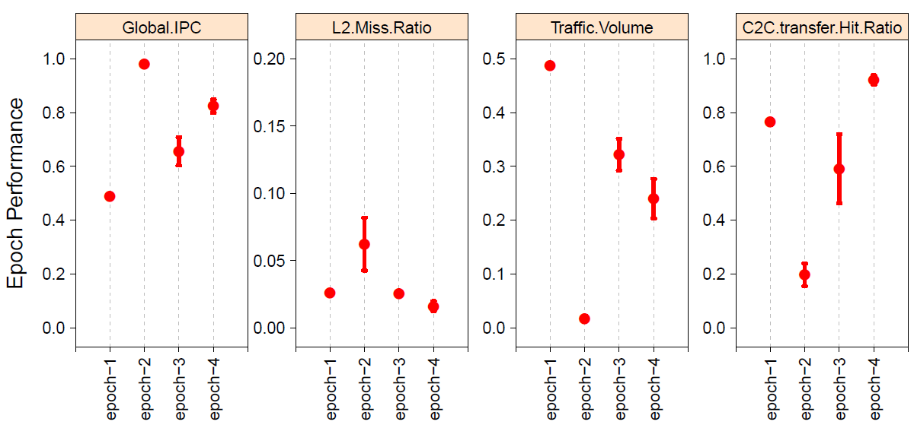
Characterization across epochs.
Error bars:
variability across the dynamic instances of an epoch
NoC Traffic
LOW variability
Dispersion across points:
variability across different epochs
HIGH variability
Notes:
This is a more qualitatiave representation of the epoch-level behavior for the same app we saw before (bodytrack) and the same metric of NoC Traffic
The different points indicate different epochs.
Each point represents the average behavior of the epoch across all its dynamic instances that occur during execution.
So by looking the error bars around a point, we see the behavioral variability that exists across those instances.
In contrast, by looking at the variability between the different points, what we see is size of the variability across completely different epochs.

Slide 13
Characterization across epochs.
Low variability across instances of an epoch
Global IPC
High variability across different epochs
L2 Miss Ratio
NoC Traffic
C2C Tranfers
fundamental correlation between epoch boundaries and changes in program behavior
High predictability of behavior across epoch instances

Slide 14
Characterization across epochs.
Low variability across instances of an epoch
Ratio =
High variability across different epochs
The smaller the ratio,
the sharper the behavioral shifts on epoch boundaries
the more predictable the program behavior across repeating epoch instances.
Notes:
To quantify this observation, we calculate the ratio between the two quantities.

Slide 15
PARSEC and SPLASH2 programs.
Less than 0.2 for most benchmarks.

Slide 16
Epochs’ effectiveness: characterization
Are epochs effective in characterizing the variability of program behavior?
How similar is program behavior among the different dynamic instances of the same epoch?
How different is the behavior across different epochs?
How the program behaves within the epochs?
✓
✓

Slide 17
Characterization within epochs.
Epochs may exhibit stable or other behavioral patterns within their boundaries.
Stable
Unstable
Multiphase
Internal behavior patterns reoccur and thus can be accurately predicted.

Slide 18
Characterization within epochs.
bodytrack fluidan. streamcl. barnes fmm lu ocean radiosity water-ns average

Slide 19
Characterization within epochs.
bodytrack fluidan. streamcl. barnes fmm lu ocean radiosity water-ns average

Slide 20
Characterization within epochs.
bodytrack fluidan. streamcl. barnes fmm lu ocean radiosity water-ns average
Most epochs exhibit stable behavior within their boundaries.
Close relation to classic definition of program phase.
Reoccurring Internal patterns can be predictable.

Slide 21
Epoch characterization summary
Epochs repeat in a consistent and predictable way providing a reliable granularity of the cyclic pattern of program behavior.
Epoch boundaries are likely to naturally indicate changes of program behavior
Most epochs exhibit stable behavior within their boundaries or other reoccurring predictable patterns.

Slide 22
Epochs: Advantages
Independent from the underlying architecture.
Naturally adopting variable-length intervals
Deterministic boundaries (global sync points).
Barriers can be easily captured at run time.
Many multithreaded workloads are written with barrier synchronizations.
Notes:
1. The observations are inherent characteristic of the program and not an architecture-dependent coincidence.
2. unlike an arbitrarily chosen fixed-size, epoch boundaries can naturally and more precisely align with the phase transitions
3. Barriers are single global points, and are independent of threads relative speed and the number of running threads.
4. can be easily captured at run time with simple architectural support (easily “watchable” at run time)
5. … or similar to barrier…

Slide 23
Outline
Introduction
Program epochs and characterization
Run-time epoch change detection.
Case study
Summary

Slide 24
Run-time epoch change detection.
EPOCH ID
Decision
signature
F bit
...
barrier_wait(barrier)
...
...
barrier_wait(barrier)
...
Application’s source code
Barrier B
Barrier B
Config AB
Config AB
Barrier B
Config AB
T
T
Barrier A
Barrier A
T
Barrier A
Barrier A
Barrier A
Barrier B
Barrier B
Application’s Instruction stream
Epoch Table
Reconfiguration units

Slide 25
Outline
Introduction
Program epochs and characterization
Run-time epoch change detection.
Case study.
Summary

Slide 26
Case study: Overview
Purpose: Demonstrate the applicability of the BarrierWatch approach in the context of dynamic adaptation.
Goal: Optimize energy/performance trade-off in a CMP architecture using BarrierWatch.
Adaptation Technique: DVFS applied to the NoC. (@ epoch granularity)
Notes:
Note that the purpose is not to propose a complete solution for the energy/performance management of the NoC;

Slide 27
Experimental methodology
Benchmarks:
From PARSEC & Splash2 suites (pthread).
Architectural Model
Full system simulator (simics) augmented with a cycle accurate memory hierarchy model.
Tile-based CMP model / 16 in-order cores / 2-issue width
Shared, physically distributed L2 Cache.
Mesh NoC, x-y routing.
Two-stage router pipeline, buffer size 2 per VC.

Slide 28
On-Chip DVFS
On-Chip Power consumption Model
NoC power + Background power
NoC Voltage/Frequency levels:
Frequency (GHz) | Voltage (V) | alias
3 | 0.8 | f100%
2.25 | 0.65 | f75%
1.5 | 0.5 | f50%
0.75 | 0.35 | f25%
Notes:
We split our power model into the power consumed by the NoC – that depends its voltage/frequency setting,
And the power consumed by the rest of the system that we estimate and keep constant.

Slide 29
Evaluated schemes
Schemes with fixed/static NoC frequency.
f100% (baseline).
f75%
f50%
f25%
Epoch-based DVFS schemes (adaptive architectures)
f-DVFS dyn (Run-time DVFS)
F-DVFS stat (off-line predefined DVFS settings).
Best frequency: The one that minimizes the Energy x Delay (ED product).

Slide 30
Case study: Results
Notes:
Changing the frequency level of the NoC affects both energy consumption and performance.
Lower frequency at the NoC will save power but will slow down the network, potentially affecting the overall system performance.
The graph on the left will show the overall on-chip energy savings achieved by each scheme and the graph on the right the corresponding slowdowns, for the refer applications.
All the results will be shown with respect to the baseline scheme, where the NoC operates at full frequency f100%.

Slide 31
Case study: Results

Slide 32
Case study: Results
Notes:
Reducing more the frequency of the NoC will reduce more the power consumption in the NoC.
However, the overall system-wide energy savings do not show much improvement here.
In fact most of the applications show that energy savings are worsed compared with the previous case of f75%.
This is caused by the large slowdowns seen by the application, as you can see on the right graph.
The time the application needs to complete is large enough to adverse the power reductions in the NoC to less overall energy savings.

Slide 33
Case study: Results
-83.2
-38.5
Notes:
This is exagerated when we reduce further the frequency, for example at f25%.
Here, all applications have very large slowdowns that eventually cause significan energy loss.

Slide 34
Case study: Results
-83.2
Run-time Epoch-based DVFS:
12.5% energy savings for 2.7% slowdown
-38.5

Slide 35
Case study: Results
Epoch-based dynamic schemes outperform all static scheme.
Notes:
In all cases, both epoch-based dynamic schemes outperform the static schemes.
The run-time epoch adaptive scheme follows closely and consistently the off-line based scheme,
indicating the strength of the runt-time barrier watch approach in capturing correctly the changes in program behavior.
Also, a side-result here shows that operating the NoC at 75% of full frequency is on average a better ED choice than having the NoC running at full frequency.
Lastly, there are cases where epoch-based adaptation has no room for significant improvements.

Slide 36
Outline
Introduction
Program epochs and characterization
Run-time epoch change detection.
Case study.
Summary.

Slide 37
Summary
Program-defined epochs represent well the repetitive and varying behavior of multithreaded programs.
BarrierWatch prominent method for effective run-time management in CMPs.
Desirable properties: 1. Simple and lightweight. 2. Effective at run-time. 3. Independent of the underlying architecture. 4. Well suited for Parallel applications.

Slide 38
Thank you!
Computer Frontiers 2011, Ischia, Italy.
Notes:
Hello, I am Socrates Demetriades from UPitt and today I will talk about ….

