Slide 1
Flip-N-Write: A Simple Deterministic Technique to Improve PRAM Write Performance, Energy and Endurance
Sangyeun Cho Hyunjin Lee
Dept. of Computer Science
University of Pittsburgh

Slide 2
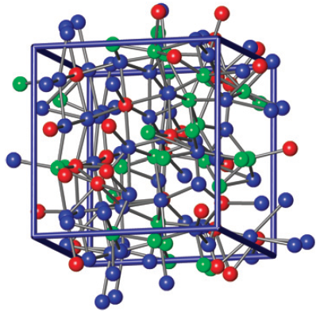
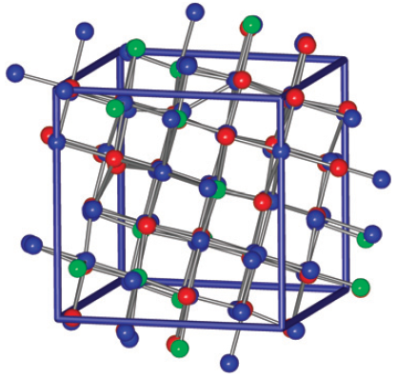
Phase-change RAM (PRAM)
bit line
V_{CC}
current
pulse
source
top
electrode
GST
memory
metal
V_{gate}
select TR
SET
RESET
Amorphous = high resistivity
Crystalline = low resistivity
(Pictures from Hegedüs and Elliott, Nature Materials, March 2008)

Slide 3
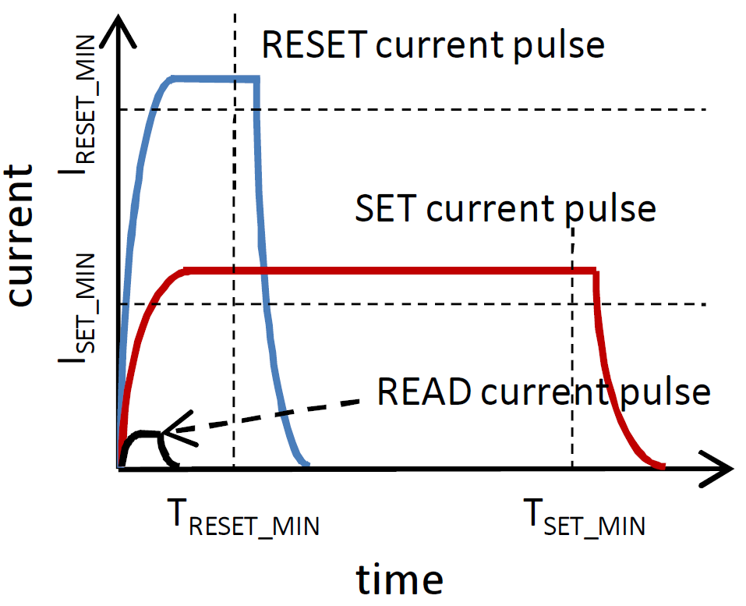
PRAM asymmetries
read latency << write latency

Slide 4
PRAM asymmetries
read power << write power

Slide 5
PRAM asymmetries
read endurance >> write endurance

Slide 6
Writes are Bad…
… and are Hated!

Slide 7
Partial writes [Lee et al. ‘09]
1
cache block replaced and written to PRAM
0
1
introduce multiple dirty bits to isolate and not write clean data
4B granularity gives a 6x improvement (over 64B)

Slide 8
Differential write [Yang et al. ‘07][Zhou et al. ‘09]
0 0 0 1 0 1 1 0
0 1 0 1 0 0 0 1
cache block replaced to be written to PRAM
content of the corresponding memory block
0 0 0 1 0 1 1 0
1 1 1 1 0 1 1 0

Slide 9
Differential write [Yang et al. ‘07][Zhou et al. ‘09]
0 0 0 1 0 1 1 0
0 1 0 1 0 0 0 1
cache block replaced to be written to PRAM
1
READ out (old) memory content
content of the corresponding memory block
0 0 0 1 0 1 1 0
1 1 1 1 0 1 1 0
0 0 0 1 0 1 1 0
1 1 1 1 0 1 1 0

Slide 10
Differential write [Yang et al. ‘07][Zhou et al. ‘09]
cache block replaced to be written to PRAM
0 0 0 1 0 1 1 0
0
0
0 0 1
0 1 0 1 0 0 0 1
2
Compare old and new data bit by bit
0 0 0 1 0 1 1 0
1 1 1 1 0 1 1 0
0 0 0 1 0 1 1 0
1 1 1 1 0 1 1 0

Slide 11
Differential write [Yang et al. ‘07][Zhou et al. ‘09]
cache block replaced to be written to PRAM
0 0 0 1 0 1 1 0
0
0
0 0 1
0 1 0 1 0 0 0 1
0 1 0 1 0 0 0 1
Probabilistically, 50% of bits will be updated;
In practice, (typically) fewer bits are updated as
bit-level redundancies are common in data
0 0 0 1 0 1 1 0
1 1 1 1 0 1 1 0
3
Update bits that differ
0 0 0 1 0 1 1 0
1 1 1 1 0 1 1 0
0
0
0 0 1

Slide 12
Contributions of this work
We propose Flip-N-Write, a differential write scheme based on Read-Modify-Write and data encoding
We use a simple bi-modal data encoding strategy: Intact or flipped
Flip bit is introduced to denote the mode
Importantly, Flip-N-Write will update at most N/2 bits at a time when updating N bits
c.f., Differential write updates at most N bits
Write power is deterministically bounded
We perform a comprehensive comparative study
Conventional write scheme
Differential write
Flip-N-Write

Slide 13
Flip-N-Write basic idea
cache block replaced to be written to PRAM
“New data”
1 1 1 1 1 1 1 1
0 0 0 1 0 0 0 1
“Old data”
0 0 0 1 0 1 1 0
1 1 1 1 0 1 1 0

Slide 14
Flip-N-Write basic idea
cache block replaced to be written to PRAM
“New data”
1 1 1 1 1 1 1 1
0 0 0 1 0 0 0 1
11 bits are different!
“Old data”
0 0 0 1 0 1 1 0
1 1 1 1 0 1 1 0

Slide 15
Flip-N-Write basic idea
cache block replaced to be written to PRAM
“New data”
1 1 1 1 1 1 1 1
0 0 0 1 0 0 0 1
“Flipped
new data”
0 0 0 0 0 0 0 0
1 1 1 0 1 1 1 0
“Old data”
0 0 0 1 0 1 1 0
1 1 1 1 0 1 1 0
Only five bits are different!

Slide 16
Flip-N-Write basic idea
cache block replaced to be written to PRAM
“New data”
1 1 1 1 1 1 1 1
0 0 0 1 0 0 0 1
“Flipped
new data”
0 0 0 0 0 0 0 0
1 1 1 0 1 1 1 0
1
“Flip bit”
“Old data”
0 0 0 1 0 1 1 0
1 1 1 1 0 1 1 0
0
(5+1) bits need be updated…

Slide 17
Flip-N-Write steps
1 1 1 1 1 1 1 1
0 0 0 1 0 0 0 1
cache block replaced to be written to PRAM
content of the corresponding memory block
0 0 0 1 0 1 1 0
1 1 1 1 0 1 1 0

Slide 18
Flip-N-Write steps
1 1 1 1 1 1 1 1
0 0 0 1 0 0 0 1
cache block replaced to be written to PRAM
1
READ out (old) memory content
content of the corresponding memory block
0 0 0 1 0 1 1 0
1 1 1 1 0 1 1 0
0 0 0 1 0 1 1 0
1 1 1 1 0 1 1 0

Slide 19
Flip-N-Write steps
cache block replaced to be written to PRAM
1 1 1 1 1 1 1 1
0 0 0 1 0 0 0 1
2
Compare old and new data and compute hamming distance
0 0 0 1 0 1 1 0
1 1 1 1 0 1 1 0
0 0 0 1 0 1 1 0
1 1 1 1 0 1 1 0

Slide 20
Flip-N-Write steps
cache block replaced to be written to PRAM
1 1 1 1 1 1 1 1
0 0 0 1 0 0 0 1
2
If hamming distance > N/2, flip new data
0 0 0 1 0 1 1 0
1 1 1 1 0 1 1 0
0 0 0 1 0 1 1 0
1 1 1 1 0 1 1 0

Slide 21
Flip-N-Write steps
cache block replaced to be written to PRAM
0 0
0 0 0 0 0 0 0 0
0
0
1
1 1 1 0 1 1 1 0
2
If hamming distance > N/2, flip new data
0 0 0 1 0 1 1 0
1 1
1 1 1 1 0 1 1 0
1
1
0
0 0 0 1 0 1 1 0
1 1 1 1 0 1 1 0

Slide 22
Flip-N-Write steps
cache block replaced to be written to PRAM
0 0
0 0 0 0 0 0 0 0
0
0
1
0 0
1 1 1 0 1 1 1 0
0 0 0 0 0 0 0 0
0
0
1
1 1 1 0 1 1 1 0
At most N/2 bits are updated;
In practice, (typically) fewer bits are updated as
bit-level redundancies are common in data
3
Update bits that differ
0 0
0 0 0 1 0 1 1 0
0
0
1
1 1 1 1 0 1 1 0
0
0
0 0 1

Slide 23
Analysis: bit update reduction
improvement
over conventional
word width

Slide 24
Analysis: bit update reduction
improvement
over conventional
improvement
over DW
word width

Slide 25
Analysis: flip bit overheads
improvement
over conventional
improvement
over DW
overhead
word width

Slide 26
Analysis: comparison with DW
DW
# bit updates/16-bit write
in-position bit flip probability

Slide 27
Analysis: comparison with DW
DW
# bit updates/16-bit write
Flip-N-Write
in-position bit flip probability

Slide 28
Implications
Savings in bit updates improves power and endurance
On average, in terms of # update bits, Flip-N-Write is better than, but not far superior to DW
However, in terms of maximum # update bits, Flip-N-Write has an edge: N/2 vs. N
This deterministic property is extremely useful with a limited cell write current requirement
Write current limited write time (M bits, S-bit update rate):
Conventional: (M/S)×T_{SET}
DW: T_{READ} + (M/S)×T_{SET}
Flip-N-Write: T_{READ} + (M/2S)×T_{SET}

Slide 29
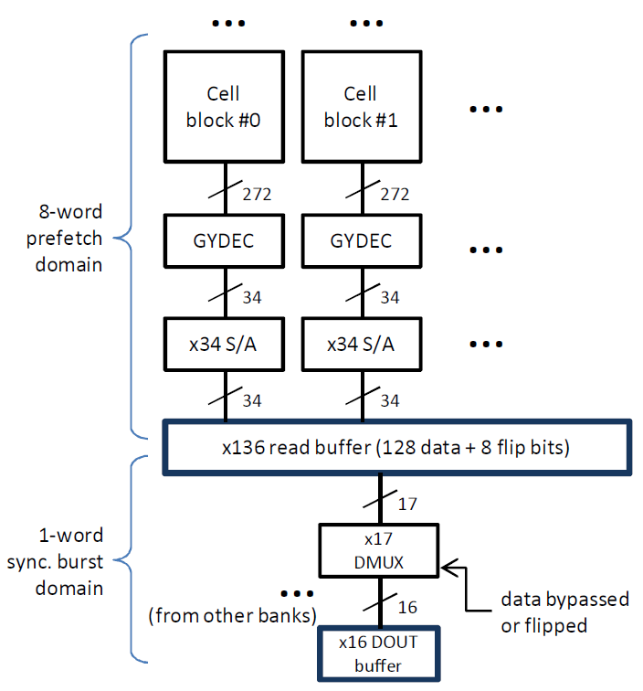
Circuit design (×16): read path
cell blocks have more bits (flip bits)
larger read buffer (flip bits)
logic for bypassing/flipping data
(Baseline design from Lee et al., ISSCC, February 2007)

Slide 30
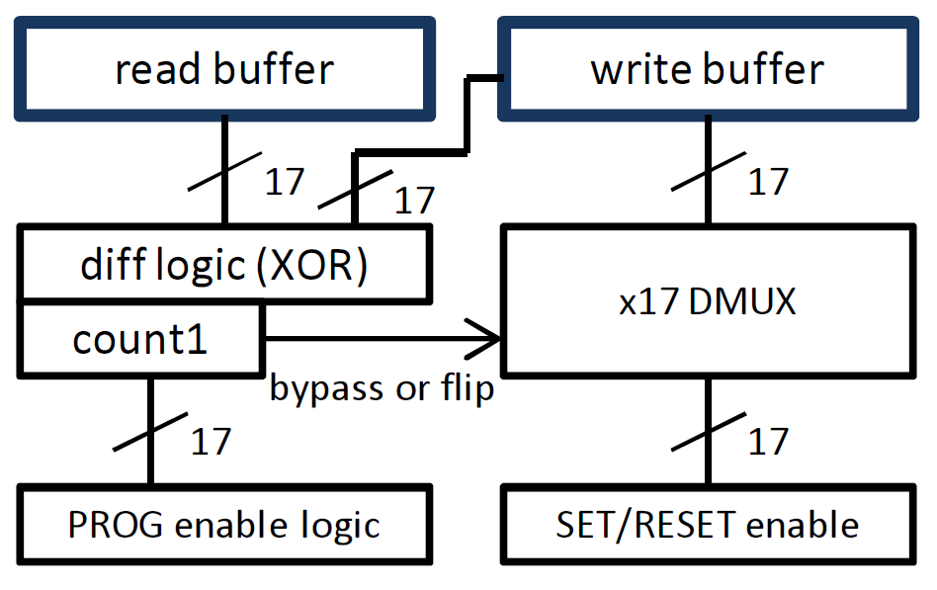
Circuit design (×16): write prep.
determine if
flipping is needed
bit mask showing
what bits need programming
bit-wise SET/RESET commands
(Baseline design from Lee et al., ISSCC, February 2007)

Slide 31
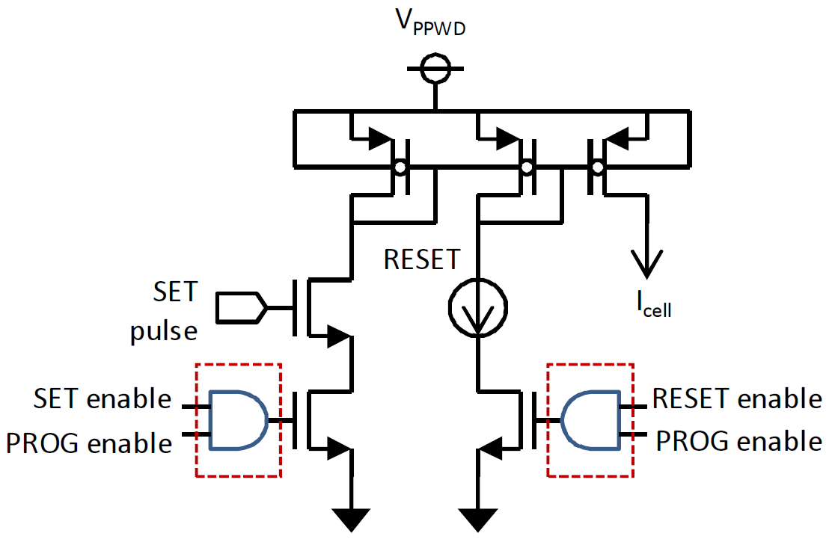
Circuit design (×16): write driver
write (SET/RESET) pulse
Cell current
SET operation suppressed
if outcome is “0” (not needed)
RESET operation suppressed
if outcome is “0”
(Baseline design from Lee et al., ISSCC, February 2007)

Slide 32
Experimental setup
We have three sets of experiments
Storage environment: # of bit updates from firmware/data update
Main memory environment: Program execution time
Four-core processor chip with ATOM-like cores
PRAMs with conventional write, DW, and Flip-N-Write
Based on Samsung’s 512Mbit prototype chip
Workloads
Firmware update: MiBench compiled with gcc
Data update: photos from New York Times “Pictures of the Day” (late April of 2009), music files “ripped” from two albums
Program run: SPEC2006 (multiprogrammed), SPLASH-2, SPECjbb

Slide 33
Firmware update (ARM)
RESET
SET
# bit updates/1,024 code bits

Slide 34
Firmware update (ARM)
conventional
Flip-N-Write
DW
RESET
SET
# bit updates/1,024 code bits

Slide 35
Firmware update (ARM)
# bit updates/1,024 code bits
Many more “SET” operations than “RESET”

Slide 36
Firmware update (ARM)
# bit updates/1,024 code bits
For DW & Flip-N-Write, # SET ~ # RESET

Slide 37
Firmware update (ARM)
# bit updates/1,024 code bits
305.7
278.6
Conventional > DW > Flip-N-Write

Slide 38
Firmware update (x86)
# bit updates/1,024 code bits
385.0
331.3
Improvement w/ Flip-N-Write over DW ~14%

Slide 39
Music file update
# bit updates/1,024 data bits
Compressed files have roughly equal 0’s and 1’s

Slide 40
Main memory performance
conventional
DW
Flip-N-Write
AMAL (cycles)
NoDelay

Slide 41
Main memory performance
AMAL (cycles)
Higher memory intensity leads to larger AMAL

Slide 42
Main memory performance
AMAL (cycles)
Flip-N-Write eases bandwidth shortage problem

Slide 43
Program performance
relative performance (to NoDelay)
PRAM write bandwidth remains a challenge…

Slide 44
Program performance
relative performance (to NoDelay)
Flip-N-Write salvages performance…

Slide 45
Bandwidth, bandwidth, bandwidth
# banks/device
L2 cache size
PRAM update time
conventional
DW
AMAL (cycles)
Flip-N-Write
NoDelay
Write bandwidth is the key to high performance

Slide 46
Conclusions
Flip-N-Write is a differential write scheme to reduce PRAM’s bit update actions using simple encoding
Power/energy reduction
Potential improvement in write endurance
Simple algorithm allows straightforward design
Deterministic bound on # update bits beneficial for power provisioning or bandwidth improvement
Faster firmware/data update latency
Performance improvement can be sizable
Write bandwidth remains a challenge

Slide 47
Flip-N-Write: A Simple Deterministic Technique to Improve PRAM Write Performance, Energy and Endurance
Sangyeun Cho Hyunjin Lee
Dept. of Computer Science
University of Pittsburgh

Slide 48
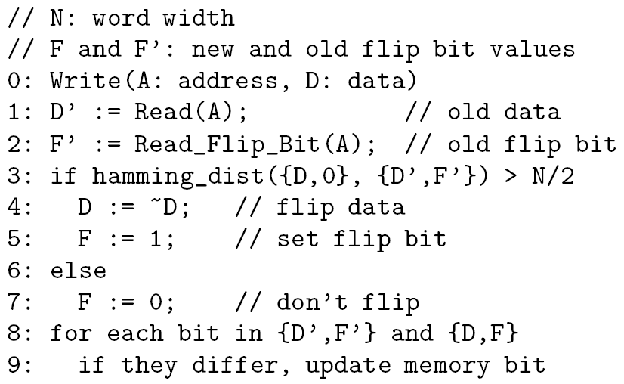
Flip-N-Write, more formally

