Slide 1
Active Disk Meets Flash:
A Case for Intelligent SSDs
Sangyeun Cho*, Chanik Park, Hyunok Oh, Sungchan Kim, Youngmin Yi, Greg Ganger
* Memory Solutions Lab. (MSL)
Memory Division, Samsung Electronics Co.
Computer Science Department
University of Pittsburgh

Slide 2
Data processing, a bird’s eye view
All data move from hard disk (HDD) to memory (DRAM)
All data move from DRAM to $$
Processing begins

Slide 3
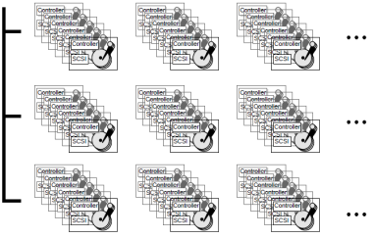
Active disk
“Execute application codes on disks!”
[Riedel, VLDB ’98]
[Acharya, ASPLOS ’98]
[Keeton, SIGMOD Record ’98]
Advantages [Riedel, thesis ’99]
Parallel processing – lots of spindles
Bandwidth reduction – filtering operations common
Scheduling – better locality
(Some) apps have desirable properties
That can exploit active disks

Slide 4
Why do we not have active disks?
HDD vendors driven by standardized products in mass markets
Chip vendors design affordable & generic chips for wider acceptance and longevity
System integration barriers
New features at added cost may not be used by many and convincing system vendors to implement support is hard
Independent advances like distributed storage
Distributed storage is similar to active disk

Slide 5
Active disk meets flash
Flash solid-state drives (SSDs) are on the rise
“World-wide SSD shipments to increase at a CAGR of 51.5% from 2010 to 2015” (IDC, 2012)
SSD architectures completely different than HDDs
We believe the active disk concept makes more sense on SSDs
Exponential increase in bandwidth!
Fast design cycles (Moore’s Law, Hwang’s Law)
We make a case for Intelligent SSD (iSSD)
Design trade-offs are very different

Slide 6
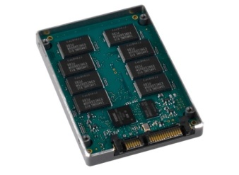
iSSD
Taps the SSD’s increasing internal bandwidth
Bandwidth growth ~ NAND interface speed × # buses
SSD-internal bandwidth exceeds the interface bandwidth
Incorporates power-efficient processors
Opportunities to design new controller chips ⇐ SSD generation gap pretty short!
Leverage parallelism within a SSD
Leverages new distributed programming frameworks like Map-Reduce

Slide 7
Talk roadmap
Background
Technology trends
Workload
iSSD architecture
Programming iSSDs
Performance modeling and evaluation
Conclusions

Slide 8
Background: technology trends
CPU
Bandwidth (MB/s)
CPU throughput (GHz × cores)
HDD
Year
HDD bandwidth growth lags seriously

Slide 9
Background: technology trends
24 ch.
SSD
16 ch.
8 ch.
4 ch.
CPU
NAND flash
Bandwidth (MB/s)
Host i/f
CPU throughput (GHz × cores)
HDD
Year
SSD bandwidth ~ NAND speed × # buses
Host interface follows SSD bandwidth

Slide 10
Background: performance metrics
Program-centric (conventional)
TIME = IC × CPI × CCT
IC = “instruction count”, CPI = “clocks per instruction”, CCT = “clock cycle time”
Data-centric
TIME = DC × CPB × CCT
DC = “data count”, CPB = “clocks per byte”
CPB = IPB × CPI

Slide 11
Background: workload
Name | Description | Input
word_count | Counts # of unique word occurrences | 105MB
linear_regression | Applies linear regression best-fit over data points | 542MB
histogram | Computes RGB histogram of an image | 1,406MB
string_match | Pattern matches a set of strings against data streams | 542MB
ScalParC | Decision tree classification | 1,161MB
k-means | Mean-based data partitioning method | 240MB
HOP | Density-based grouping method | 60MB
Naïve Bayesian | Statistical classifier based on class conditional independence | 126MB
grep (v2.6.3) | Searches for a pattern in a file | 1,500MB
scan (PostgreSQL) | Finds records meeting given conditions from a database table | 1,280MB

Slide 12
Background: workload
CPI
CPI = Cycles Per Instr
IPB
IPB = Instrs Per Byte
CPB
CPB = IPB×CPI!
CPB = Cycles Per Byte

Slide 13
iSSD architecture
CPU(s)
On-Chip
SRAM
Flash Channel #0
CPUs
On-Chip
SRAM
Flash
Memory
Controller
ECC
…
Host Interface Controller
…
Host
DMA
Embedded
Processor
Scratchpad
SRAM
…
DRAM
Controller
Flash
Memory
Controller
Flash Channel #(n_{ch}–1)
ECC
…
Bus
Bridge
Stream
Processor
Flash
Interface
Main
Controller
Config.
Memory
DRAM
zero₀
zero_{N-1}
NAND Flash Array
…
ALU₀
…
enable
R_{0,0}
ALU_{N-1}
R_{0,0}
result
…
ALU₀
zero
R_{N-1,1}
ALU₀
…
R_{0,1}
ALU_{N-1}
…
ALU₀
…
enable
R_{0,0}
ALU_{N-1}
R_{N-1,0}
result
…
ALU_{N-1}
zero
R_{N-1,1}
ALU₀
…
R_{N-1,1}
ALU_{N-1}
Scratchpad SRAM Interface

Slide 14
Why stream processor?
Imagine flash memory runs at 400MHz (i.e., 400MB/s bandwidth @8-bit interface)
Imagine an embedded processor runs at 400MHz
If your IPB = 50; even if your CPI is as low as 0.5, your CPB is 25 ⇒ 25× speed-down!
Stream processing per bus is valuable
Increases the overall data processing throughput
Reduces CPB with reconfigurable parallel processing inside SSD

Slide 15
Instantiating stream processor
a.x
sub
mul
x₁,…,x_{k}
min
add
for each stream input a
for each cluster centroid k
if (a.x-x_{k})^2 + (a.y-y_{k})^2 < min
min = (a.x-x_{k})^2 + (a.y-y_{k})^2;
a.y
sub
mul
zero
y₁,…,y_{k}
x₁,…,x_{k}
enable
add
0
y₁,…,y_{k}
enable
add
0
(k-means)
CPB improvement of examples:
3.4× (linear_regression), 4.9× (k-means) and 1.4× (string_match)

Slide 16
How to program iSSD?
Extensively studied
E.g., [Acharya, ASPLOS ’98], [Huston, FAST ’04]
We use Map-Reduce as the framework for iSSDs
Initiator: Host-side service
Agent: SSD-side service
MapReduce Runtime
(Initiator/Agent)
1
Applications
(Database, Mining, Search)
Application initializes the parameters
(i.e., registering Map/Reduce functions
and reconfiguring stream processors)
2. Application writes data into iSSD
Application sends metadata to iSSD
(i.e., data layout information)
Application is executed
(i.e., the Map and Reduce phases)
5. Application obtains the result
Mapper
MapReduce Runtime (Initiator)
Reducer
Mapper
File System
File A
1
Device driver
File B
Mapper
File C
Reducer
Host interface
Mapper
MapReduce Runtime (Agent)
MapReduce
Output
data
Reduce
Phase
Interme-
diate data
Map
Phase
Input
data
FTL
Embedded
CPU
DRAM
Flash
Smart SSD
FMC
Flash

Slide 17
Data processing strategies
Pipelining
Use front-line resources in SSD (e.g., FMC, embedded CPU) before host CPU
Filter/drop data in each tier
Partitioning
If SSD takes all data processing, host CPUs are idle!
Host CPUs could perform other tasks or save power
Or, for maximum throughput, partition the job between SSD and host CPUs
We can employ both strategies together!

Slide 18
Performance of pipelining
D: input data volume (assumed to be large)
B: bandwidth (1/CPB)
Steps (t*)
Data transfer from NAND flash to FMC
Data processing at FMC
Data transfer from FMC to DRAM
Data processing with on-SSD CPUs
Data transfer from DRAM to host
Data processing with host CPUs
T_{total} = serial time + max(t*), B = D / T_{total}

Slide 19
Performance of partitioning
Input D is split into D_{ssd} and D_{host}
D_{ssd} is processed within SSD and D_{host} is transferred from SSD to host for processing
Host interface is not bottleneck if D_{host} is small
T_{total} = max(D_{ssd}/B_{ssd}, D_{host}/B_{host})
B_{host} can be put: n_{host_cpu}×f_{host_cpu}/CPB_{host_cpu}

Slide 20
Also in the paper…
Validation of performance models
Prototyping results using commercial SSDs
Detailed energy models for pipelining and partitioning
linear_regression
string_match
k-means
model
model
model
sim
sim
sim
Cycles
model (XL)
model (XL)
sim (XL)
sim (XL)
model (XL)
sim (XL)
0
0
0
1 2 4 8 16
1 2 4 8 16
1 2 4 8 16
# flash channels

Slide 21
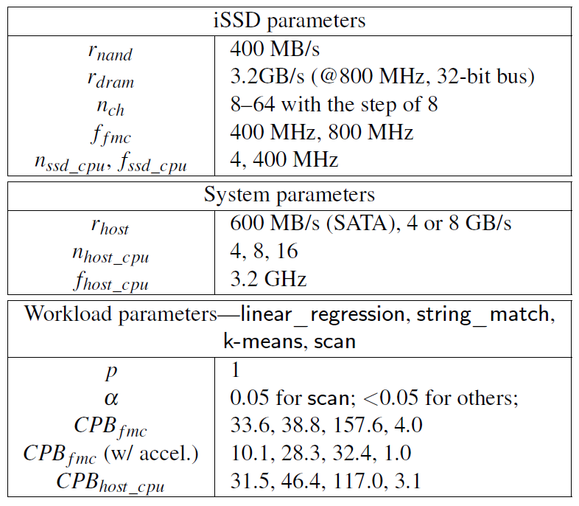
Studied model parameters

Slide 22
Performance (= throughput)
linear_regression
string_match
Data processing rate (MB/s)
Data processing rate (MB/s)
HOST-*
HOST-4/8G
HOST-SATA
Number of FMCs
Number of FMCs
For linear_regression and string_match, host CPU performance (8 cores) is the bottleneck

Slide 23
Performance (= throughput)
linear regression
string_match
Data processing rate (MB/s)
Data processing rate (MB/s)
HOST-*
HOST-4/8G
ISSD-400
HOST-SATA
ISSD-400.
Number of FMCs
Number of FMCs
Utilizing a simple embedded processor per channel in SSD is insufficient for these two programs

Slide 24
Performance (= throughput)
linear regression
string_match
ISSD-XL
ISSD-XL
Data processing rate (MB/s)
Data processing rate (MB/s)
HOST-*
HOST-4/8G
ISSD-400
HOST-SATA
ISSD-400.
Number of FMCs
Number of FMCs
“Acceleration” with stream processor (ISSD-XL) is shown to be effective, more for linear_reg.

Slide 25
Performance (= throughput)
linear regression
string_match
ISSD-XL
ISSD-800
ISSD-XL
Data processing rate (MB/s)
ISSD-800
Data processing rate (MB/s)
HOST-4/8G
HOST-*
ISSD-400
HOST-SATA
ISSD-400.
Number of FMCs
Number of FMCs
Circuit-level speedup (ISSD-800) is better than ISSD-XL for string_match
There may be opt. opportunities for string_match

Slide 26
Performance (= throughput)
k-means
scan
Data processing rate (MB/s)
HOST-*
Data processing rate (MB/s)
HOST-8G
HOST-SATA
HOST-4G
Number of FMCs
Number of FMCs
k-means: host CPU limited
scan: host interface bandwidth limited

Slide 27
Performance (= throughput)
k-means
scan
ISSD-XL
ISSD-XL
ISSD-400.
ISSD-800
Data processing rate (MB/s)
HOST-*
Data processing rate (MB/s)
ISSD-800
HOST-8G
ISSD-400.
HOST-SATA
HOST-4G
Number of FMCs
Number of FMCs
Both programs benefit from stream processor
Smart SSD approach is very effective for scan because of SSD’s very high int. bandwidth

Slide 28
Iso-performance curves
r_{host} = 600 MB/s
k-means
string_match
linear_regression
Raw performance
4 host CPUs =
64 FMCs
Number of FMCs
scan
Number of host CPUs
Measures when a Smart SSD performs better than host CPUs

Slide 29
Iso-performance curves
r_{host} = 600 MB/s
k-means
string_match
linear_regression
string_match-XL
Number of FMCs
k-means-XL
linear_regression-XL
scan
scan-XL
Number of host CPUs
Acceleration with stream processor improves the effectiveness of the iSSD

Slide 30
Iso-performance curves
r_{host} = 600 MB/s
r_{host} = 8 GB/s
k-means
string_match
k-means
linear_regression
string_match
linear_regression
scan
string_match-XL
linear_regression-XL
Number of FMCs
Number of FMCs
string_match-XL
k-means-XL
k-means-XL
scan-XL
linear_regression-XL
scan
scan-XL
Number of host CPUs
Number of host CPUs
When host interface is very fast: host CPUs become more effective, but iSSD is still good!

Slide 31
Energy (energy per byte)
I/O
SSD
NAND
I/O
DRAM
Energy Per Byte (nJ/B)
chipset
main
memory
SP
processor
host
CPU
iSSD energy benefits are large!
At least 5× (k-means) and the average is 9+×

Slide 32
Summary
Processing large volumes of data is often inefficient on modern systems
iSSD execute limited application functions (or simply new features) to offer high data processing throughput (or other values) at a fraction of energy
iSSD design is different from active disks
Very high internal bandwidth
Internal parallelism
Relative insensitivity to data fragmentation

Slide 33
Active Disk Meets Flash:
A Case for Intelligent SSDs
Sangyeun Cho*, Chanik Park, Hyunok Oh, Sungchan Kim, Youngmin Yi, Greg Ganger
* Memory Solutions Lab. (MSL)
Memory Division, Samsung Electronics Co.
Computer Science Department
University of Pittsburgh

