Slide 1

TPTS: A Novel Framework for Very Fast
Manycore Processor Architecture Simulation
Sangyeun Cho, S. Demetriades, S. Evans,
L. Jin, H. Lee, K. Lee, and M. Moeng
Dept. of Computer Science
University of Pittsburgh

Slide 2
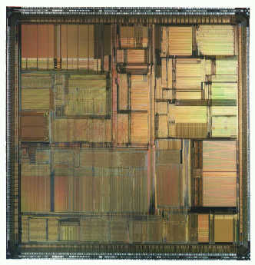
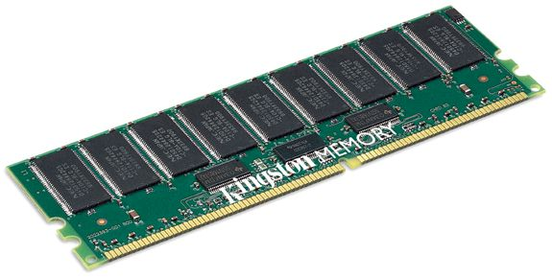
Architect’s sword: simulator
target machine
definition
simulator
simulation
result
program
input
Software-based simulator is flexible
  Unlimited modeling capabilities
  Arbitrary level of accuracy
37 out of 46 papers in ISCA ’07 employed a simulator

Slide 3
But simulations take LONG…
(1.7 days)
(22 hours)
(11 hours)
(7.3 min)
(1 sec)
(gcc slowdown)
Detailed simulation of SPEC2k can take well over 1 month on a dedicated workstation [Wunderlich, WDDD ‘04]

Slide 4
Our contributions
TPTS (Two-Phase Trace-Driven Simulation)
  Idea of separation of time-consuming microarchitectural simulation into two phases: trace generation & trace simulation
  Framework for very fast multicore simulators
Identification of key design issues
  Simulating OoO processors?
  Simulating multithreaded workloads?
Our prototype – tsim
Evaluation of ideas using tsim

Slide 5
Ideas for fast simulation
Full trace-based simulation [Barnes, ISPASS ‘07]
Reduced input set, e.g., MinneSPEC [KleinOsowski & Lilja, CAL ‘02]
Simulation points [Sherwood et al. ASPLOS ‘02]
Statistical sampling, e.g., SMARTS [Wunderlich et al., ISCA ‘03]
These techniques may be still expensive at an early design stage…
Multicore processors take even LONGER to simulate
We want: a simulator that is 100x faster than today’s execution-driven simulation techniques, <10% absolute error, correct prediction of performance changes
whole execution w/ detailed simulation
N instructions
t=0
sampled periods
t=T
representative phases
t=T_{ACTUAL}+T_{SKIPPED}+T_{WARM-UP}
t=T_{ACTUAL}+T_{SKIPPED}+T_{WARM-UP}

Slide 6
Trace-driven simulation
phase #1
phase #2
program
target machine
definition
input
trace
trace generator
trace
trace
trace simulator
simulation
result
Phase 1 is one-time effort; phase 2 is “repeated”
Fast – simplicity of trace simulation phase
Platform independence of traces

Slide 7
Our idea – TPTS /tip-see/
phase #1
phase #2
program
target machine
definition
input
trace
timing-aware
trace generator
trace
annotated
trace
trace simulator
analysis,
filtering
simulation
result
generic machine
definition
Trace generation is timing-aware
Machine definition is used in trace generation
Analysis and filtering techniques for trace annotation

Slide 8
Where is simulation time spent?
gcc, OOO-4
Simulation time (%)
Simulation time, cumulative (%)
sim-outorder functions

Slide 9
Where is simulation time spent?
gcc, OOO-4
“pipeline” related
Simulation time (%)
“memory” related
Simulation time, cumulative (%)
sim-outorder functions

Slide 10
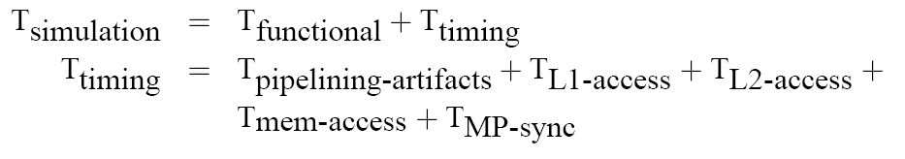
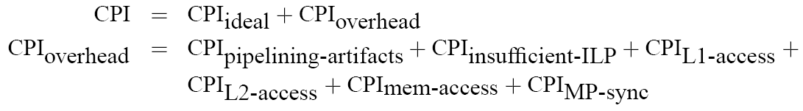
Where is simulation time spent?
Much simulation time is spent modeling pipeline artifacts; focus of multicore simulation is however on system effects
There are relatively constant CPI components over simulation runs ⇒ we can compute them once during trace generation
Note. TPTS tackles both T_{functional} and T_{timing}

Slide 11
TPTS – trace items
Q. What becomes trace items?
Full trace: 15 items
Memory trace: 4 items
L1 hit filtered trace: 2 items
TPTS uses filtered traces
non-mem instr
N_{instr} = 15
mem instr
N_{mem} = 4
N_{miss} = 2

Slide 12
TPTS – trace items
Q. What information does each trace item carry?
N_{instr} = 7
N_{cycles} = 9
N_{mem} = 2
item #102
n_inst = 6
n_mem = 1
n_cycles = 11
n_type = ld_miss
addr=0x014c
item #102
item #103
n_inst = 7
n_mem = 2
n_cycles = 9
n_type = st_miss
addr=0x0220
item #103

Slide 13
Benefits of filtering
Assume 30% of instructions are memory accesses
Assume L1 cache hit rate of 90%
Q. How many instructions are covered by one trace item?
A. 33. You have 30%×(1–90%)×100 = 3 trace items per 100 instructions.
If L1 hit rate is 95%, each trace item corresponds to 66 instructions.
Reduced trace processing time, reduced trace file sizes.
Higher simulation accuracy – timings during trace generation are accurate

Slide 14
OoO cores?
Trace-driven simulation is not suitable for OoO processor modeling, given up [Black et al. ICCD ‘96]
Q. Does trace filtering help here?
A. Partly, if you have few L1 cache misses. Error is introduced only on cache misses.

Slide 15
Naïve method; in-order vs. OoO
168%
309%
Difference in simulated program exec. time (%)
Trace-driven simulation works well for in-order processors
Won’t work for OoO; it’s not possible to re-create the OoO scenarios on long-latency events such as L2 cache miss

Slide 16
Instruction permeability analysis
Approach. Evaluate the potential impact of an L2 miss at trace generation time
Idea. Measure the impact of a hypothetical miss

Slide 17
Instruction permeability analysis
168%
309%
Outorder-1
Outorder-2
Difference in simulated program exec. time (%)
Outorder-1. Error <10%.
Outorder-2. Error ~15%.
Error has to do with L1 miss rate (trace interval) and OoO window size

Slide 18
Multithreading?
Q. Would timing-aware trace generation affect TPTS accuracy, esp. when dealing with locks?
A. Possibly. We need to generate trace items for “high-level” primitives, not individual memory accesses for locks.

Slide 19
Multithreading?
Q. Would filtering affect TPTS accuracy, esp. when dealing with race conditions?
A. Possibly. We can turn off filtering in critical regions, all together or selectively.
time

Slide 20
tsim
Our prototype multicore simulator
Configurable network (topology & network), processor count, memory controller count, L2 cache memory.

Slide 21
Evaluation setup
Configurations
  Baseline: 512kB L2 slice per node, 300-cycle memory
  B-16: baseline w/ 16kB L1 cache
  B-32: baseline w/ 32kB L1 cache
  B-64: baseline w/ 64kB L1 cache
  M-180: same as B-16, but memory latency is 180 cycles
  M-240: same as B-16, but memory latency is 240 cycles
  C-256: same as B-16, but L2 cache slice is 256kB
  C-128: same as B-16, but L2 cache slice is 128kB
tsim vs. Simics-based (in-house) performance simulator

Slide 22
tsim – speed vs. absolute error
B-64
B-32
B-16
simulation speedup
timing error
Speedup. 20~900, average >100
Absolute error. <8%, typically <5%
Speedup and error have to do with filtering (cache size)

Slide 23
tsim – performance prediction
program exe. time relative to B-16
machine configuration
Performance direction is correctly predicted
Magnitude of performance difference had some error

Slide 24
tsim – trace overhead
Q. What about trace generation overhead?
A. Overhead is ~1.1 of simulation. Simulation speedup is achieved in an experiment w/ only 2 simulation runs. For example w/ 5 runs, speedup = 5/(1.1 + 5×0.01) = 4.35.
Q. What about trace files? Aren’t they big?
A. Yes, but hard drives are cheap. In our current design, 100B-instruction trace files are 8~80GB. Standard file compression gives us 80% file size reduction.
Q. What about the raw simulation speed?
A. It was 146.5 MIPS (simulated MIPS). Multiprogrammed workloads utilizing 100 cores feasible.

Slide 25
Conclusions
TPTS is a valuable concept for building a very fast multicore processor simulator
  Target of studies is on system-wide resources such as: interconnection network, memory controllers, shared cache memory, directory, …
Trace-driven OoO processor simulation will be interesting
  Our results in this work are promising
Our prototype–tsim– shows that TPTS leads to faster simulation speeds at small errors
TPTS tools can be practical and useful, esp. at an early design stage

Slide 26

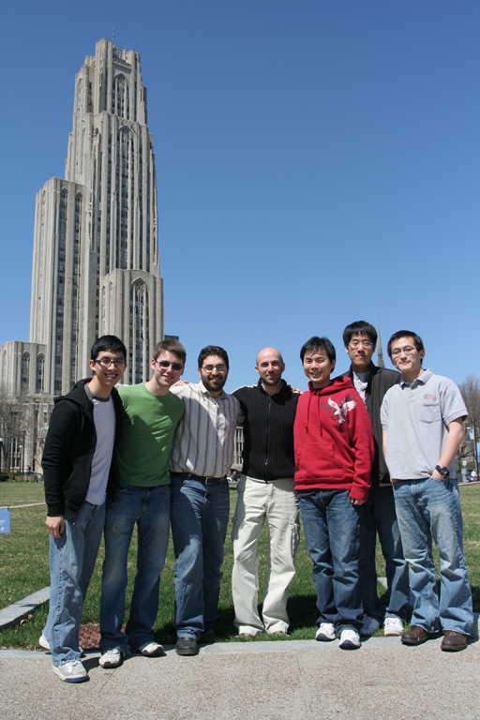
tsim team
TPTS: A Novel Framework for Very Fast
Manycore Processor Architecture Simulation
Questions?

Slide 27
Future work
Trace-driven OoO processor simulation
  This has not been seriously studied in the past
  We have encouraging results in this work & our current work
More benchmark programs
  We are currently generating traces from PARSEC
Improving tsim
  Detailed DRAM memory model

